Slide 1
The Non-everyday tasks of payroll
Presenter: Margie R. Pontillo
Accounting Manager
Archdiocese of Miami
mpontillo@theadom.org
305-762-1281

Slide 2
Goals of this class
This class is intended to be a refresher for bookkeepers and administrators on payroll issues that you do not have to deal with on an everyday basis, but that are an important part of your payroll function.
We will cover the following subjects:
Tax Exemption Certificates
Priest: Pension payment and 403b participation
UCT-6 Filing when and who must file it
Priest Income, 1099 or W-2? Expense reimbursements taxable?
Pension Plan yearly Data request: Are you doing it right?

Slide 3
Tax Exemption Certificates
What you need to know:
The Pastoral center process the application of all tax exemption certificate for all Archdiocese of Miami Schools and Parishes.
The State office sends all correspondence directly to the address of the entity.
Application for renewal can be submitted to the state 3 month before it expires.
The application gets sent to the entity directly.
The Finance office can provide you with a copy of the application (mato@theadom.org)
You only have to submit to the pastoral center is a copy of the old certificate and a signed application.
Parishes have to apply for Religious Physical Place of Worship
Schools Apply for School college or University

Slide 4
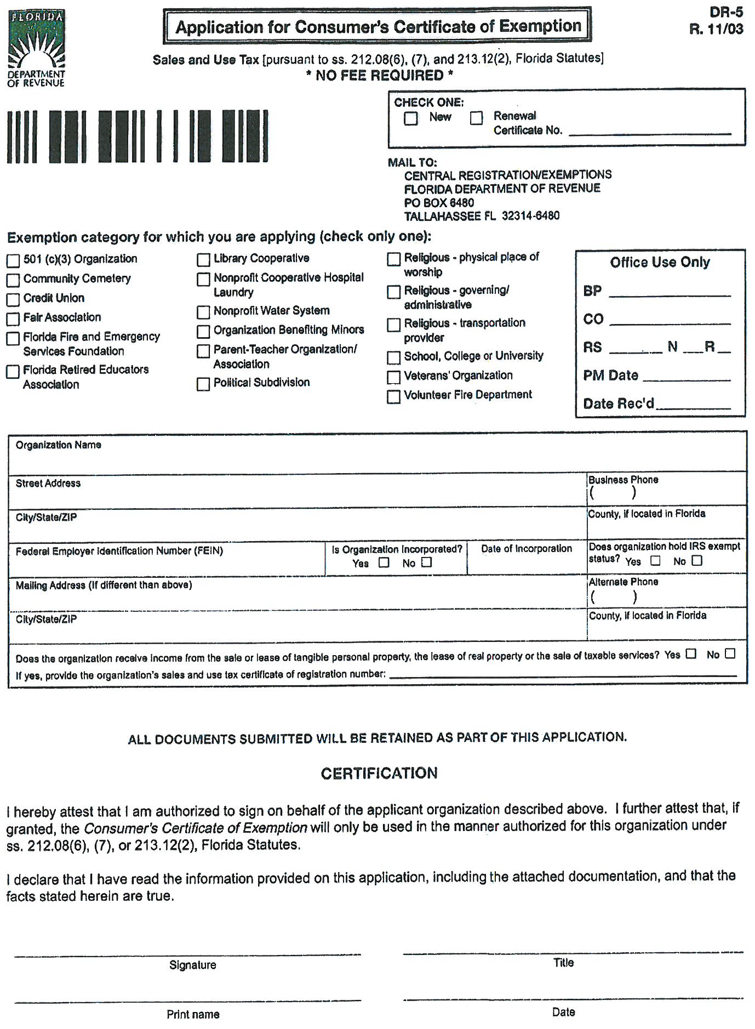

Slide 5
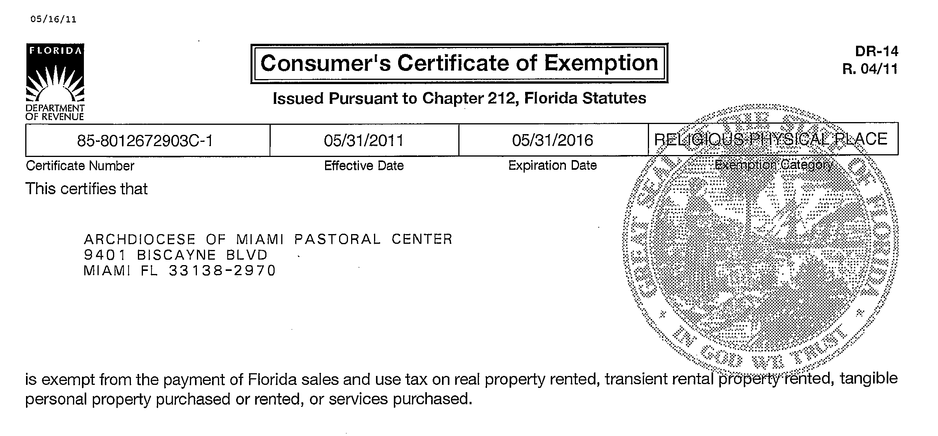

Slide 6
Retirement benefits by employee classification
Classifications | Plan | Description
Laity | -Cash Balance | -Invoice will come monthly from Gabriel Roeder and Smith
 | -403b | -If employee elects to participate, employee deduction and employer match will be issued through the payroll process
Incardinated Priests | -Pension | -Invoice will come monthly from Gabriel Roeder and Smith
 | -403b | -If priest elects to participate, employee deduction and employer match will be issued through the payroll process
Extern Priests | -403b | - you will need to send a check monthly to Mass Mutual for the amount of $291.67 (Yearly employer contribution of $3,500)
 |  | -If priest elects to participate, employee deduction and employer match will be issued through the payroll process
Religious Priests | -Order Plan | - you will need to send a check monthly to the priest's order for the amount of $337.50 (Yearly employer contribution of $4,050)
Religious Brothers and Sisters | -Hired before 1985 | -Invoice will come monthly from Gabriel Roeder and Smith
 | -Hired after 1985 | - you will need to send a check monthly to the religious order for the amount of $337.50 (Yearly employer contribution of $4,050)
Notes:
Let’s take a look at those who serve in our Archdiocese and how ADOM provides for their retirement.
Which groups do not participate in the 403(B)? Anyone know why?

Slide 7
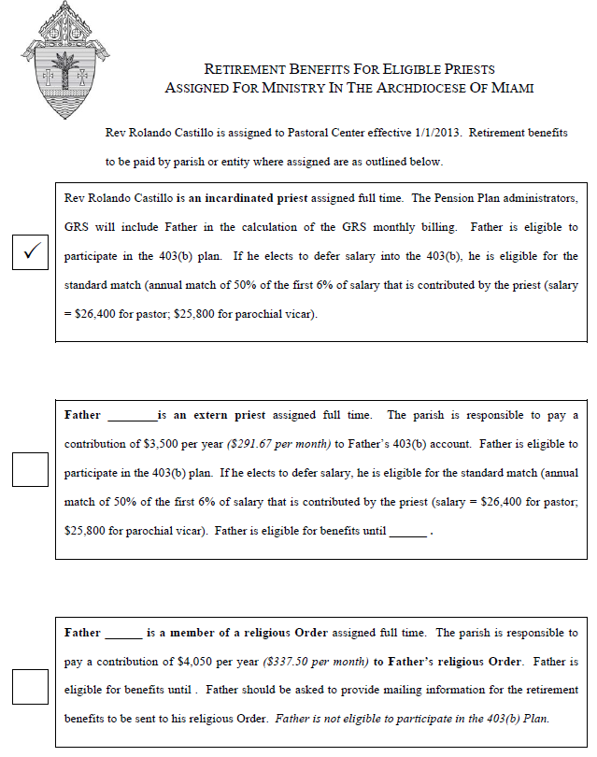

Slide 8
Payments to be done:
Write monthly check to Gabriel Roeder and Smith for:
Laity Cash balance contribution
Incardinated Priests pension contribution
Religious Brothers and Sisters hired before 1985 pension contribution.
Write check to 403b for:
Laity withholding and employer match on each payroll
Incardinated Priests withholding and employer match
Extern Priests withholding and employer match
Extern priests monthly contribution of $291.67
Write monthly check to Religious orders for:
Religious Priests $337.50 monthly contribution to the Order
Religious Brothers and Sisters $337.50 monthly contribution to the order for those hired AFTER 1985

Slide 9
Things to Remember for regular 403(b) processing
Employer match = 50% of the first 6% contributed by the employee.
All contributions have to be a whole percentage.
The Logos expense account for the 403b employer match is: 5154-0000-100
Any % changes on an employee contribution you have to review and recalculate the employee match in the same pay period the change is made

Slide 10
UCT-6 Filing
Unemployment Compensation Tax
Information you may need to know:
Although the Archdiocese of Miami and its entities do not need to pay quarterly tax, we do need to file the UCT-6 report.
All employees in the payroll need to be entered.
Priests should not be entered.
Tax rate is .000
“Signature” is your Signature, the person filing.
After filing you’ll receive a page with a confirmation number. Print this page and e-mail it or fax it to Jennifer James @ James Chartered Inc.

Slide 11
Uct-6 Filing Unemployment vs. UCT-6
Who pays for what?
All late fees and penalties related to the late filing or not filing of the UCT-6 reports are the responsibility of the entity.
All unemployment claims are paid by the pastoral center of the Archdiocese of Miami as they are part of your yearly Property and liability insurance.

Slide 12
UCT- 6 and unemployment
Have a question, who to call?
Jennifer James
James Chartered, Inc.
863-680-1372 Fax
863-686-5993 Phone line
jmjames@tampabay.rr.com
Where do I go to file my UCT-6 report?
http://dor.myflorida.com

Slide 13
Priest Income
W-2 or 1099?
All paid income issued to an priest assigned to your entity is to be reported on a w-2.
All priests have to fill out a w-4 in order to be added to payroll
Expense reimbursement can be processed though accounts payable and is not reported as income in the w-2 as long as receipts and documentation is provided to support the expense.
Visiting priests have to fill out a w-9 and must be issued a 1099 at the end of the year.

Slide 14
Pension Plan Yearly Data request

Slide 15
Pension Yearly Data request form
What you must know:
Data request forms are mandatory and they have to be submitted by the deadline stipulated by the pension plan.
If box 1 of the employees w-2 form does not include their full remuneration, you have to include all pre-tax deductions into the other compensation column.
Other compensation could be items such as:
403(b) pretax contributions
Health plan pre-tax contributions

Slide 16
Are expense reimbursements taxable?
NO – expense reimbursements are not taxable.
Is mileage reimbursement taxable? – No
Is a food expense reimbursement taxable? - No
Is office expenses reimbursements taxable? – No
The key point here is that all these are reimbursements, so invoice and/or documentation has to be presented to support such expenses. If there is no receipt and/or documentation it is to be reported as income.
Receipts Reimbursement
No Receipt Income

Slide 17
This presentation will be posted at www.theadom.info in the
Folder: Human Resources / Training and Presentations

Slide 18
If you have not already seen the new site, you may wish to check out the now developing Archdiocesan extranet site, e-library.
http://www.theadom.info/ User ID and password included in attached pdf document.
The site will serve as depository of the forms, policies, and other documents we need to make available to the parishes and schools as well as CHS, STU, CC or any other entities of the Archdiocese. Just now developing but enough here to give you an idea how it operates. Several folks will be responsible for posting and maintaining current documents. I am hopeful this will reduce duplication, use of home-made forms (wishful thinking?), out of date forms, etc. and make readily available policies and manuals that are useful for the parishes. It will take a while to get folks to use the e-library but at least this will get us started. Some of the handouts at the employee conference on Aug 8 will be distributed via the web and it will be shown to the new pastors on the 22nd at the workshop and then formally rolled out to all after that.

Slide 19
Frequently-Asked-questions
Questions?

