Slide 1
Tapping into Greatness
Planning Week 2022-23

Slide 3
Loving God,
You made each of us differently.
We all have our own unique histories, our own personalities, our own gifts.
We have our own faults, biases, and shortcomings.
Yet all that we have is yours.
In the months ahead,
Please grant us the faith
To join with you in a single Body.
Teach us to appreciate our differences
As we celebrate our unity.
Thank you for the gift of leadership in our Church.
May our daily work contribute fully to your ministry
And may we always be part of the Body of Christ.
Amen

Slide 4
What does it mean to be One Body in Christ?

Slide 5
As a grade level team describe what does it mean for us as at community to be One in the Body of Christ?
What unique talents, skills, and experiences do you possess that help to build up SBS’ “Body”?
Create an infographic to share.

Slide 6
What does it mean to be One Body in Christ? All have gifts and talents that we bring to SBS community. Together we are doing the work of God.

Slide 7
Our Mission as Catholic Educators Congregation for Catholic Education (2022)
“In the Catholic school’s educational project there is no separation between time for learning and time for formation”
“The life of the Catholic teacher must be marked by the exercise of a personal vocation in the Church…”
“Catholic schools…Participate in the evangelizing mission of the Church and represent the privileged environment in which Christian education is carried out.”
“We must not lost our missionary impetus to confine ourselves on an island, and at the same time we need the courage to bear witness to a Catholic ‘culture’, that is, universal, cultivating a healthy awareness of our own Christian identity.”
Instruction "The Identity of the Catholic School for a Culture of Dialogue (25 January 2022) (vatican.va)

Slide 8
Archdiocese of Miami Office of Catholic Schools Goals
2022-23

Slide 9
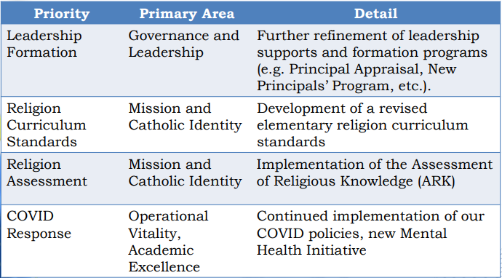

Slide 10
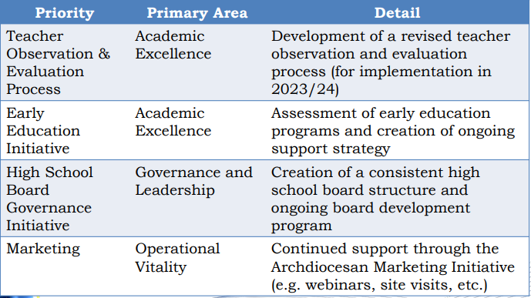

Slide 11
St. Bonaventure Catholic School Goals
2022-23

Slide 12
Goal 1 | Primary Reading Program
NSBECS Domain(s) | Academic Excellence
Description | Implement a developmental, accelerated, and preventive reading program which includes explicit phonics instruction and core knowledge building to ensure that all students can read on or above grade level when exiting 2nd grade as indicated by the quarterly STAR Reading assessment.
Specific Steps | Reading Horizons Professional Development Reading Horizons Coaching (2 days) Reading Horizons Master Teacher Individual Teacher Observation and Feedback Core Knowledge Professional Development Horizontal and Vertical bimonthly Professional Learning Communities to discuss instructional practices and review formative data Classroom resource teacher push in ( 90 min daily) Instructional Coach/Admin weekly check in’s for instruction guidance Accelerated Reading, partnering with families to create daily routines for reading practice, increase student fluency, comprehension, and vocabulary Quarterly STAR Reading/ Early Literacy Assessments
Measurement (how will we measure success?) | All students reading on or above grade level when exiting Kindergarten, 1st, and 2nd grade as indicated by the STAR Reading assessment

Slide 13
Goal 2 | Faith Formation
NSBECS Domain(s) | Catholic Mission of the School
Description | Provide faith formation in which students are enabled to build and deepen their relationship with God within their family, school, and parish community.
Specific Steps | Grade level retreats (K-8) led by SBS students and alumni Monthly student led parish masses Family prayer experiences- SBS prayer bear, Holy Family, Our Lady of the Rosary, and Vocations pray and share (like Student of the Week with Prayer) Promotion of parish youth group events Inter bimonthly Religion PLC’s to discuss student faith formation Intra bimonthly PLC’s to include our faith in cross curricular STREAM units Monthly family prayer section in school newsletter
Measurement (how will we measure success?) | Parent Surveys (Specific Questions): Students in our school are encouraged, through all aspects of their school experience, to develop a closer relationship with Jesus Christ Our school helps parents/guardians support the faith life of their child. Our school has a clearly articulated rigorous curriculum infused with Gospel values that prepares students for life and work.

Slide 14
Goal 3 | Secondary Writing Program
NSBECS Domain(s) | Academic Excellence
Description | Teachers will incorporate writing in all subject areas in grades K-8. Teachers will provide students with authentic feedback on formal writing assignments. Teachers will utilize IXL to improve writing mechanics. Portfolios and WrAP assessment will be utilized to monitor progress.
Specific Steps | Writing Professional Development Vertical bimonthly Professional Learning Communities to discuss instructional practices, build common rubrics, and review student writing samples Instructional Coach monthly observations/ check in’s for instruction guidance Vertical standards for writing annotations to be used in all subjects Encourage formal writing process in all subjects
Measurement (how will we measure success?) | Improve student writing in all subject areas in grades 3-8 as measured by 85% of students meeting or exceeding grade level expectation on the Writing Assessment Program (WrAP)

Slide 15
Goal 4 | STREAM Curriculum
NSBECS Domain(s) | Academic Excellence
Description | Establish STREAM grade level curriculum goals
Specific Steps | Students initiate inquiry-led projects relevant to their community in collaboration with faculty, students, and other visiting STREAM professionals. STEM teacher professional learning community writing STREAM curriculum that aligns vertically Engage teachers in classroom best practices around a strong, project-based STEM curriculum Professional Development to acquire a rigorous understanding of core science and engineering concepts and their pedagogy Apple Teacher professional development and assessments Reflection on grade level STREAM Curriculum Maps Integration of Argument Driven Inquiries (ADI’s,) and the Scientific Method, and the Engineering Design Process into curriculum maps in Grades 3-8
Measurement (how will we measure success?) | Student achievement levels to be increased by five percentile points on Terra Nova assessment in Science

Slide 16
Goal for PLC’s: Examine and increase the rigor and relevance in classroom lessons. Reflection on current content, instructional methods, and routines allow teachers to make informed instructional decisions that directly impact student learning.

Slide 17
Building Relationships
Module 1

Slide 18
Connection
How do you make a connection with your students?

Slide 19
Connection
Greet your students by name every day
Learn their interests
Know their weaknesses and address them
Leverage strengths so students feel supported
Building a culture where students feel safe to make mistakes

Slide 20
Compassion
Show understanding
Work toward a positive behavior pattern
Teach students how to reduce stress in real time
Provide students with strategies to regulate behavior
Model for students how to show compassion to classmates

Slide 21
Vulnerability
Learning is courageously vulnerable
Frustration, confusion, productive struggle
Use growth mindset language
Reframe failures as normal opportunities to grow
Share stories of set backs and growth

Slide 22
PAUSE & REACT Tool

Slide 23
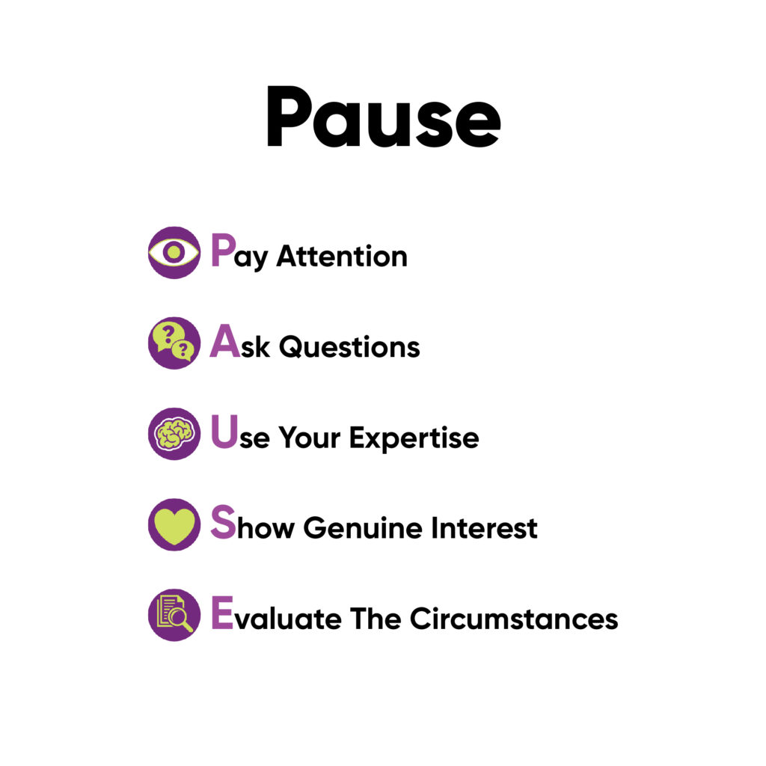

Slide 25
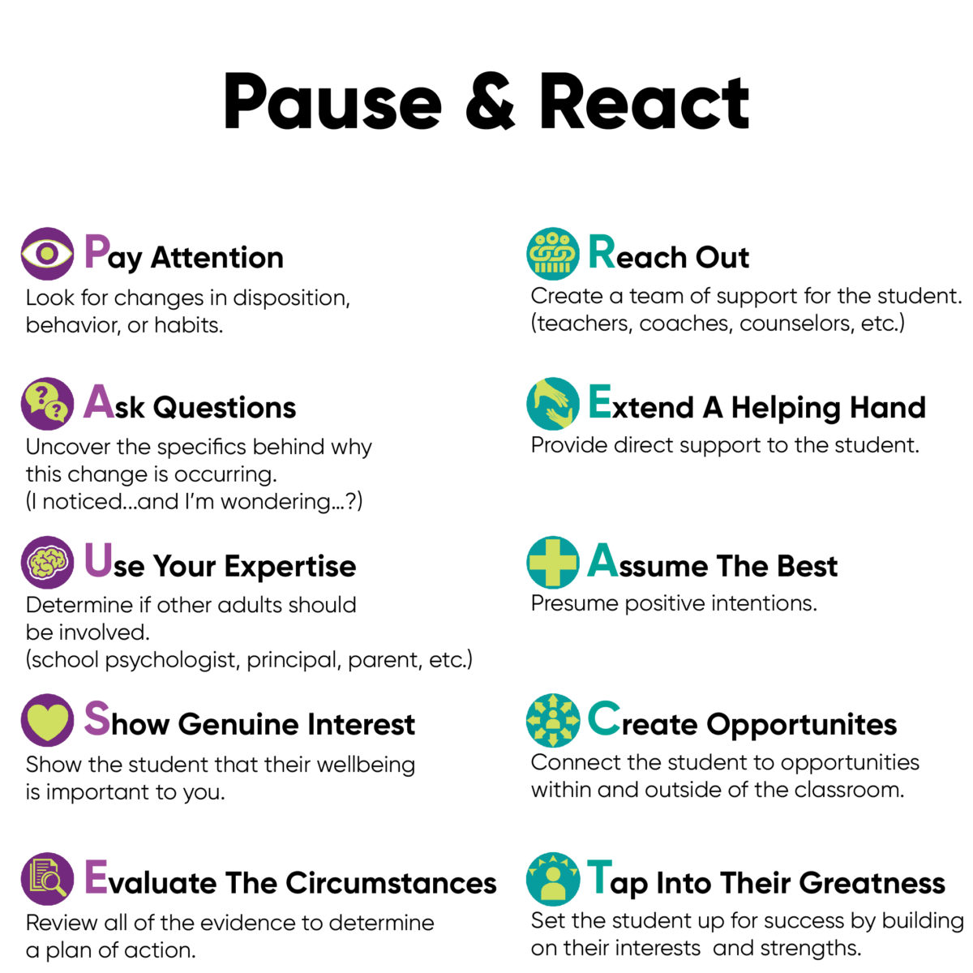

Slide 26
PAUSE & REACT comes into play when you notice that a particular student is no longer responding to those efforts or is showing signs that they are struggling socially, emotionally, or academically. Each child is in need of strong learning relationships, often expressed in different ways, and this tool offers the flexibility to address the needs and nuances of every student.

Slide 27
Prioritizing Standards
Module 2

Slide 28
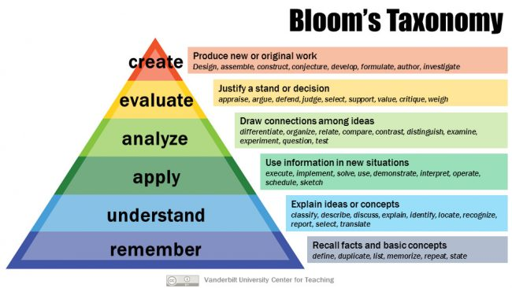

Slide 29
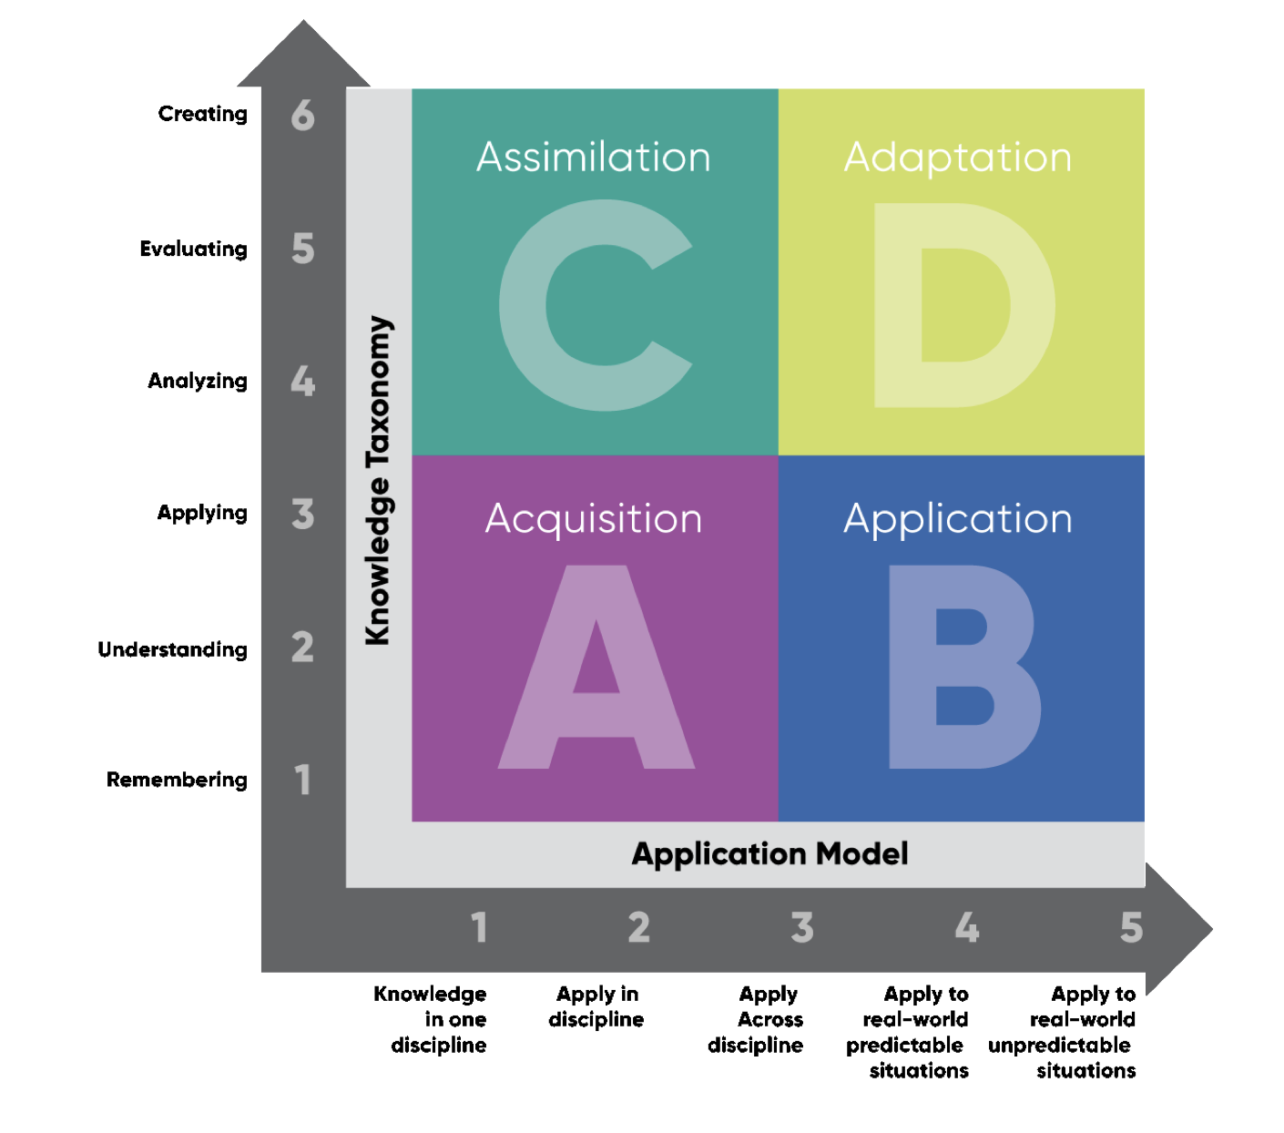

Slide 30
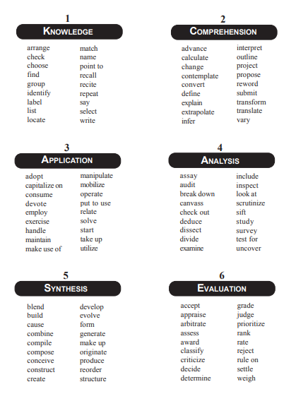

Slide 31
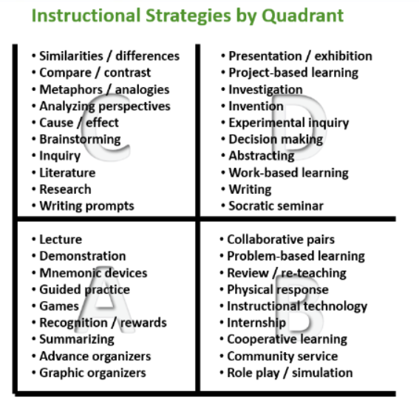

Slide 33
Criteria for Priority Standards
Readiness- is this standard needed for the next level of learning
Endurance – does this standard contain concepts and skills that last over time
Leverage – crossover application to other subjects

Slide 34
Take the next 15 minutes to highlight standards that you consider to be Priority Standards…

Slide 35
Personalized Learning
Module 3

Slide 36
Defining Elements of Personalized Learning
Voice
Students taking ownership over their learning
student led conferences (middle school)
students using individual white boards
think pair share

Slide 37
Defining Elements of Personalized Learning
Choice
Students taking ownership over their learning
student playlists
student choice boards
novel choices on same topic- literature circles
elective choices

Slide 38
Defining Elements of Personalized Learning
Path, Pace, Place
Students taking ownership over their learning
student seat choice
walk and talk

Slide 39
Experiential Learning
Module 4

Slide 41
Project Based Learning
Problem Based Learning
Learn and use skills to produce a project
Directly linked to the curriculum
One similar result
Learning process to produce a potential solution to a problem
Process focused
Wide range of a solutions

Slide 42
Discuss your curriculum maps with your grade level? How can they be improved?

Slide 43
Engaging Routines
Module 5

Slide 44
Engagement Routines
Idea Wave
Jigsaw
Numbered Heads
Simultaneous Response
Think Write Pair Share
Response Frames

Slide 46
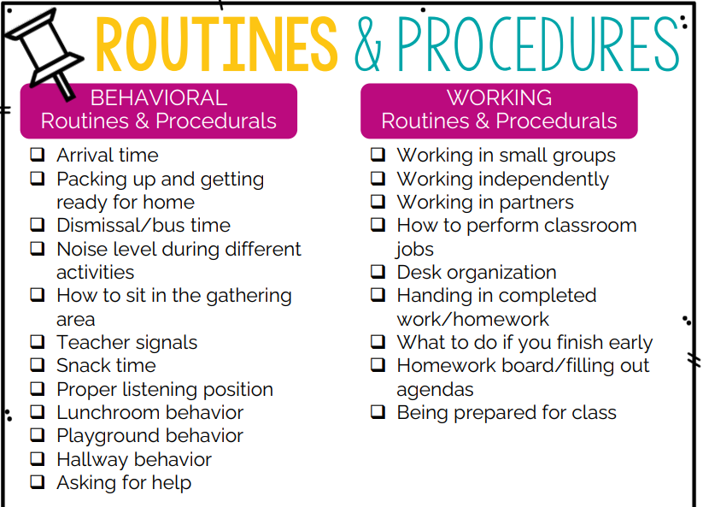

Slide 47
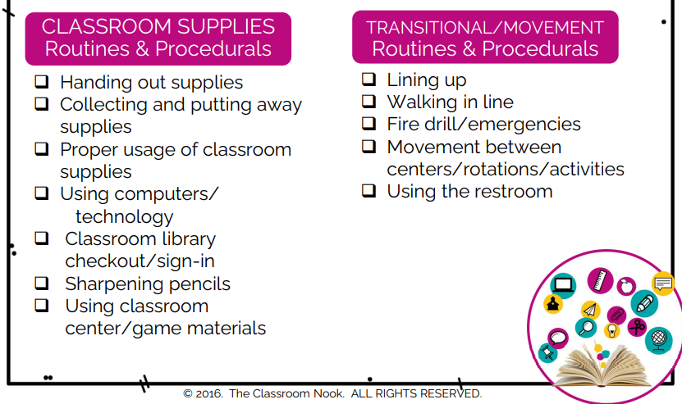

Slide 48
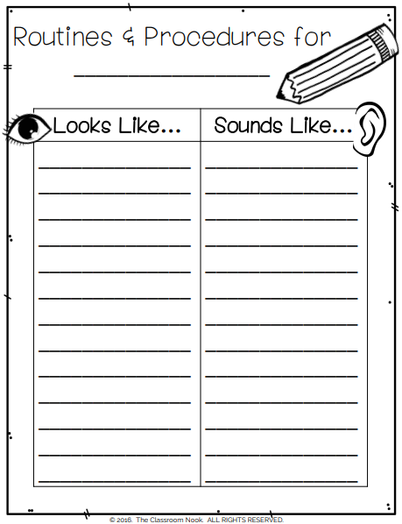

Slide 49
References
Ainsworth, L., & Donovan, K. (2019). Rigorous Curriculum Design: How to Create Curricular Units of Study That Align Standards, Instruction, and Assessment (Icle Professional Publications). International Center for Leadership in Education.
International Center for Leadership in Education. (2022). ICLE Learning Toolkit (1st ed.). ICLE.
Lemov, D. (2021). Teach Like a Champion 3.0: 63 Techniques that Put Students on the Path to College (3rd ed.). Jossey-Bass.
Nook, T. C. (2022, June 3). Back to School Series: Setting Up Classroom Routines and Procedures. THE CLASSROOM NOOK. Retrieved August 9, 2022, from https://www.classroomnook.com/blog/classroom-routines-and-procedures

Slide 50
Tapping Into Greatness
Goal: Examine and increase the rigor and relevance in classroom lessons. Reflection on current content, instructional methods, and routines allow teachers to make informed instructional decisions that directly impact student learning.
1.0
Prioritize Standards
2.0
Personalized Learning
3.0
Experiential Learning
4.0
Engagement Routines
5.0
Building Relationships
1.1
Review Rigor/ Relevance Framework
2.1
Student Choice Boards samples
3.1
Professional development on ADI, DBQ, and Orations
4.1
Professional development:
Idea Wave
Jigsaw
Numbered Heads
Simultaneous Response
Think Write Pair Share
Response Frames
5.1
Review SEL Standards
2.2.1
Freckle
5.2
SEL Professional development:
Compassion
Connection
Vulnerability
1.2
Provide Verb List by Quadrants: Application, Acquisition, Assimilation, Adaptation
2.2
Tutorial on how to utilize adaptive technology
3.2
Cross-curricular lesson planning components form
2.2.2
IXL
4.2
Complete a Daily Routine Examination Form
2.3
Student Led Conference Forms
1.3
Deconstruct wording of grade level standards by verbs to separate into quadrants.
5.3
Professional development:
Pause and React
3.3
Grade level planning meeting to formulate two semester cross-curricular project lesson plans
4.3
Share Daily Routine Examination with grade level partners
2.4
Student Led Conference Form samples
1.4
Prioritize standards based on quadrants
2.5
Personalized Playlist Examples

