Slide 1
So you are on Facebook…Now what?

Slide 2
Who is where?

Slide 5
Have a Purpose for being in the platform

Slide 7
Answer the Question: What do you want to accomplish?

Slide 8
Set your goals and objectives based on what you want to accomplish

Slide 9
Be realistic and make objectives measurable and attainable

Slide 10
Once we have all this down…

Slide 11
…then we worry about content

Slide 12
What makes good content?

Slide 13
Types of content:

Slide 14
Stories and Links

Slide 15
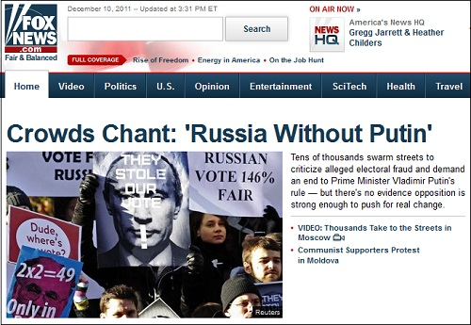

Slide 16
When you share these stories in social media make sure: - To share a good visual with it - To include a good/catchy description of the story (don’t simply repeat the title of the story)

Slide 17
Graphics and images

Slide 18
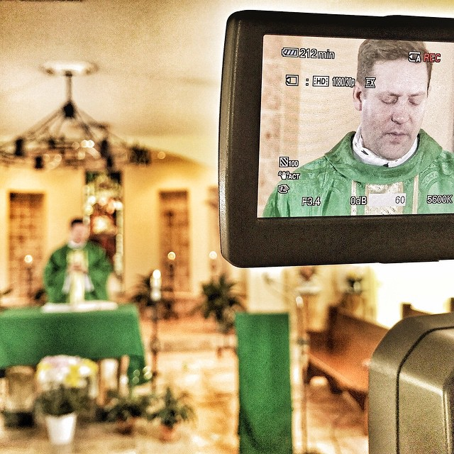

Slide 19
Infographics

Slide 22
Memes

Slide 23
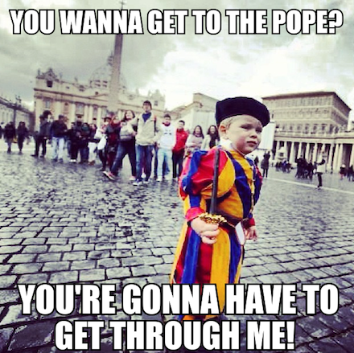

Slide 24
Videos

Slide 26
Quotes

Slide 28
Gifs

Slide 29
How to create content based on what your audience likes?

Slide 30
First you have to identify your audience

Slide 32
Next, search for what your audience likes

Slide 33
Demographics ---- Psychographics

Slide 34
Craft your posts based on what they like / expect out of following you

Slide 35
Imitate the Pro’s but make it your own

Slide 36
Track your results

Slide 37
Analytics

Slide 38
Important things to look at

Slide 39
Total Reach
Post clicks
Link clicks
Engagement
Likes
Comments
Retweets
Shares
Favorites

Slide 40
Do more of what works for you

Slide 41
End of session 1…
Stay tuned for session 2
Topics:
Privacy settings
Handling social media emergencies
New social media trends and platforms

Slide 42
Quick recap of session 1
Recognizing your audience
Figuring out their tastes and likes: demographics / psychographics
Content:
Type of content
How to create content
Analytics

Slide 43
Keeping it safe…adjusting your settings

Slide 44
Depending on the social media platform, settings will be different

Slide 45
In general pay attention to:
Who is allowed to publish, comment on your timeline
What content is visible to whom
Age restrictions (applies to Facebook mostly)
Profanity filters (applies to Facebook mostly)
Set up phone notifications for (comments made in your profile)
Have only approved page administrators (and have more than one)

Slide 46
What else can you do…
Spell out the rules and regulations of your page (when applicable)
Have boiler plate language that includes contact info in case someone wishes to report misuse of the platform

Slide 47
Dealing with the tough…social media emergencies

Slide 48
Comments

Slide 49
Comments that are abusive, insulting, threatening or libelous should be eliminated
Comments that violate the rules and regulations explicitly expressed in the “about” section of the page or profile can be eliminated (upon the discretion of the page’s administrator).
Dissenting comments, but that are expressed in appropriate language and without insulting other users should be allow to remain in the page.
Any comment that raises a concern of security, or safety should be deleted, upon reporting it to the appropriate authorities (ex. Police, supervisor, the Communications Office, Safe Environment Office etc.)

Slide 50
When an inappropriate post gets published

Slide 51
If something inappropriate is posted, the administrator must inform the appropriate supervisor.
The piece of content must be deleted.
If necessary, an apologize must be issued.

Slide 52
When is blocking acceptable?

Slide 53
When a user violates the rules and regulations of the page as set by the administrator(s).
When there is verbal abuse against another user or against anyone.
Verbal abuse includes use of profanity, language that is unkind or that is said with the intention of bullying another user.
When it might be libelous.
When there is a consistent pattern of spamming.

Slide 54
Stay tuned for our digital communications policy

Slide 55
New emerging platforms

Slide 56
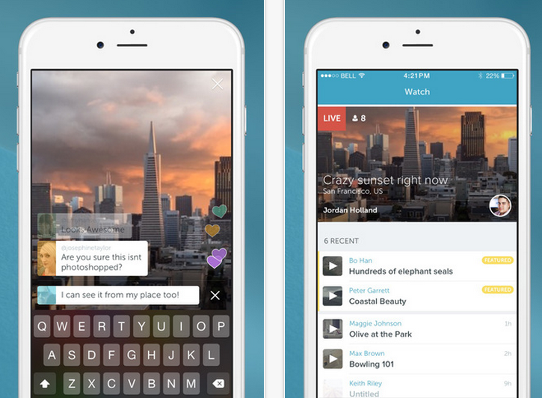
Periscope

Slide 57
Periscope
Is a live video streaming app for iOS and Android.
Users of Periscope are able to choose whether or not to make their video public or simply viewable to certain users such as their friends or families.
Broadcasts can be saved to the user’s phone and or replay for 24 hours within the app.
A user can watch public broadcasts from all over the world.
How can we use it?

Slide 58
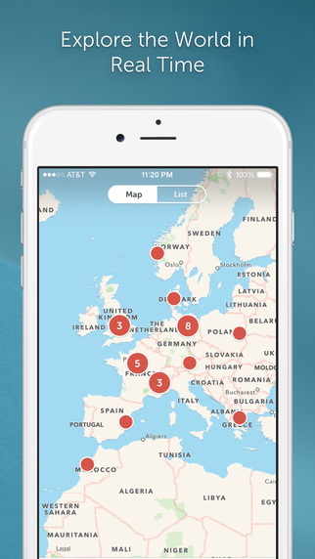

Slide 59
Meerkat
It’s another mobile app that enables users to do live video streaming over the web via Twitter.
Up to 5,000 people can watch the video streaming at a given time.
Meerkat vs. Periscope: What's the difference? (CNBC News)

Slide 60
Snapchat
What is it?

Slide 61
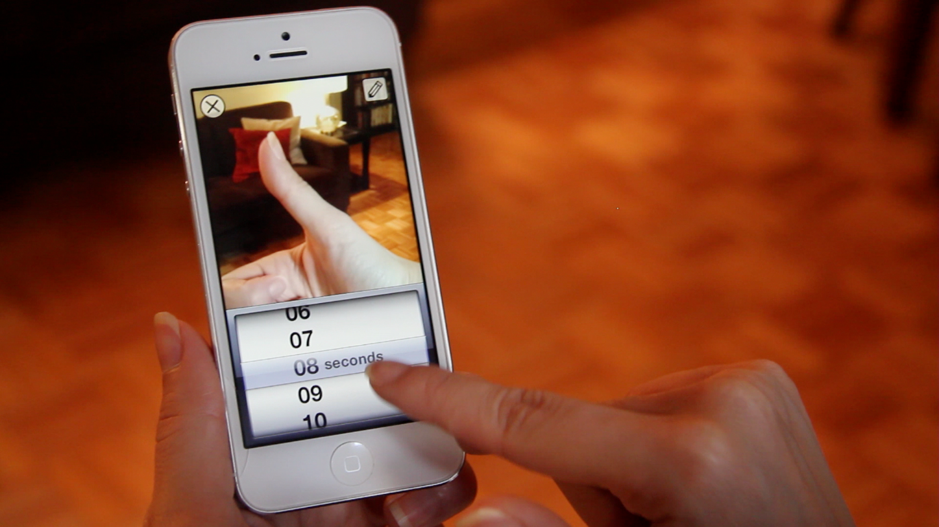
Allows you to take pictures and videos and send them to your connections
The user can add text and or doodle in the image or video
Once videos are seen they disappear
However people can take screen shots of them
How could you use it?

Slide 62
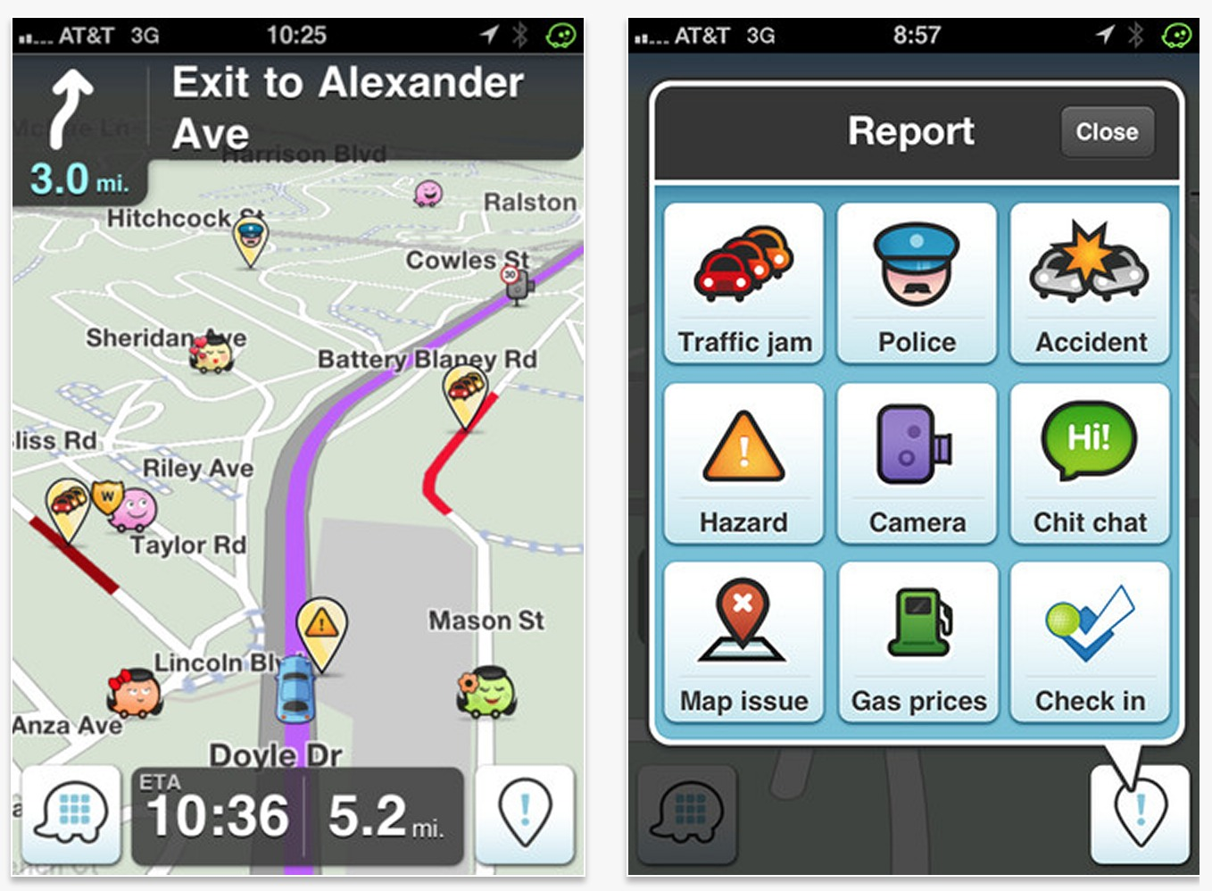
Waze
What is Waze?

Slide 63
How to use it to your advantage?
Waze allows for places to be promoted while the user drives by it…
If you are a school, a parish, or any establishment, you are going to want to appear.
You can do promotions or paid ads in Waze so the user can get a pop up message indicating that you are close by.
It’s bringing the flock while they are close to you…

Slide 64
Open floor…Questions?

Slide 65
The End

