Slide 1
Bookkeeper, HR, Finance Workshop for parishes, Schools and other entities
Meryann Hernandez
305-762-1295
mhernandez@theadom.org
St. Martha Catholic Church
Archdiocese of Miami

Slide 2
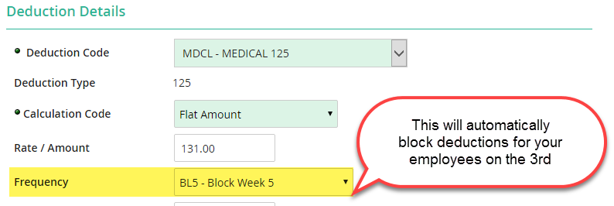
PAYROLL Do’s & DON’T’S
PROCESS PAYROLL….ON TIME! Absolute deadline is Wednesday by 4:00 pm.
Make all your changes to employees’ profile prior to processing Payroll. This includes the approval of any changes made by the employees. (Tools Menu/Pending Changes)
Make sure all medical deductions are on Block Week 5 frequency and 403B are on “ All” frequency
Time off policies and types should be set up for all benefit eligible employees.
Teacher’s personal days’ record is to be kept by the bookkeeper.
Make sure you have documentation to support any RATE changes you enter into personnel profile.

Slide 3
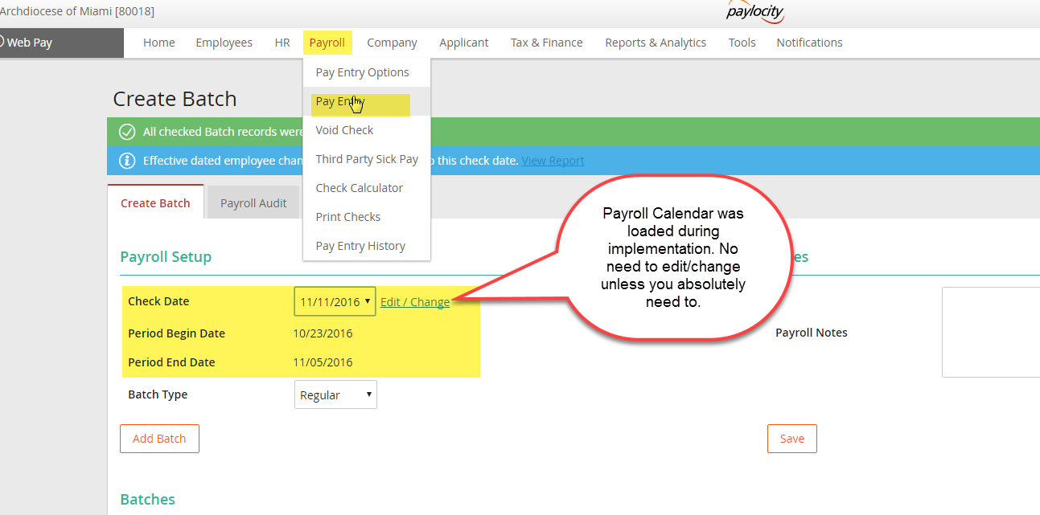
PAYROLL Do’s & DON’T’S
Creating a Payroll Batch :

Slide 4
PAYROLL Do’s & DON’T’S

Slide 5
PAYROLL Do’s & DON’T’S

Slide 6
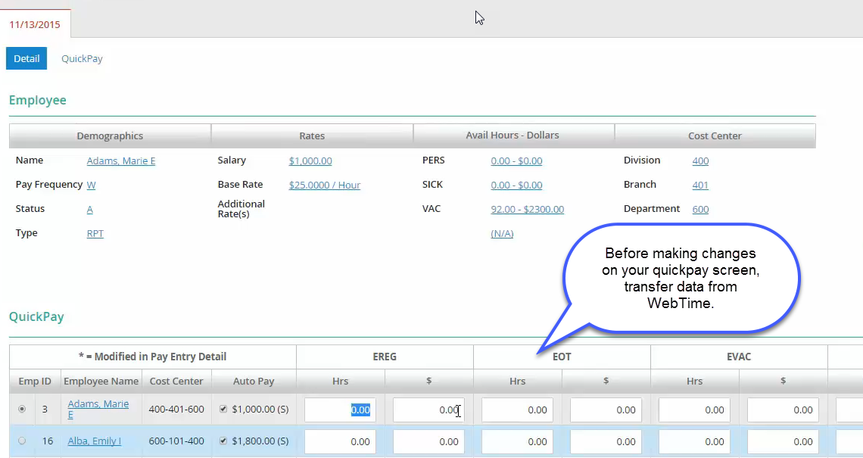
PAYROLL Do’s & DON’T’S
Ready to process? Not quite….

Slide 7
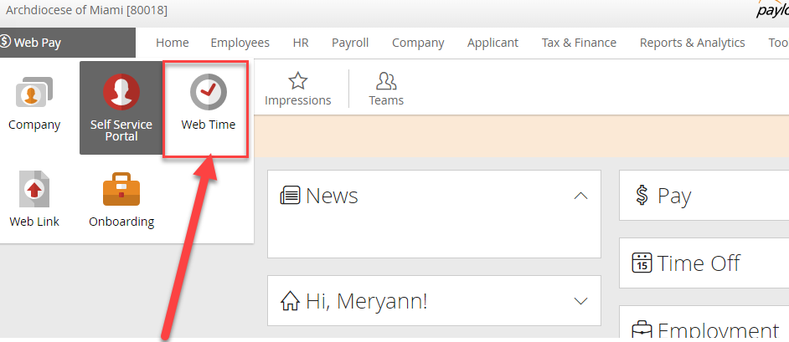
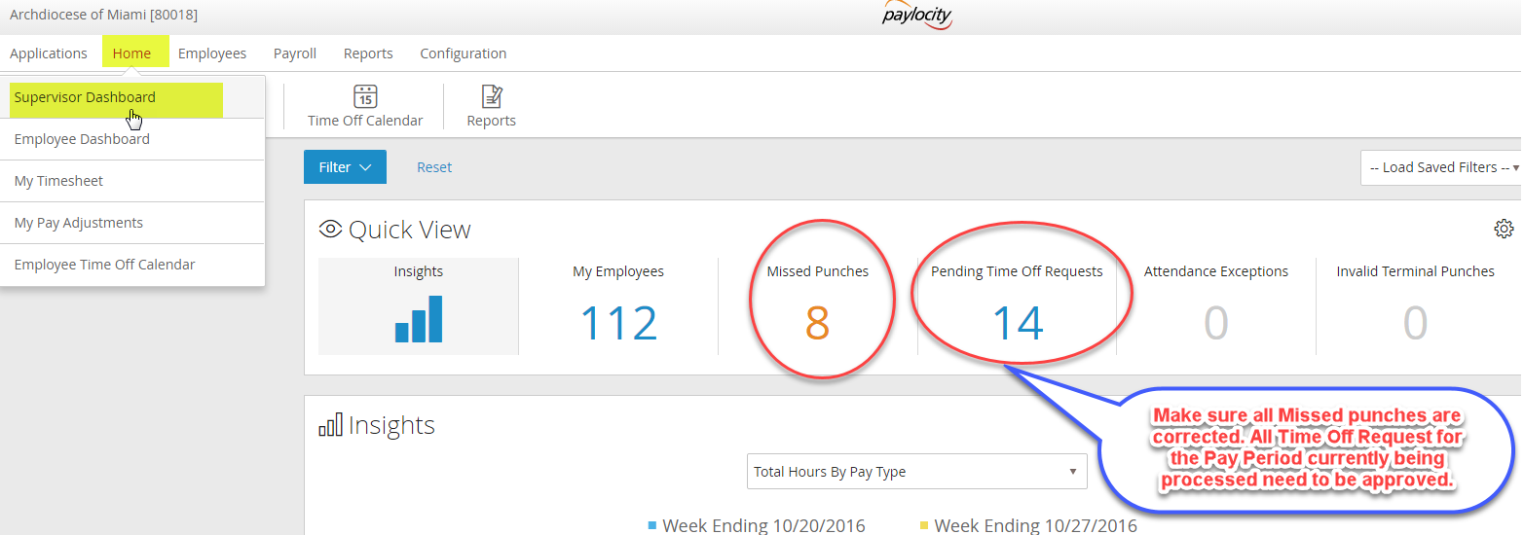
PAYROLL Do’s & DON’T’S
WebTime Transfer

Slide 8
PAYROLL Do’s & DON’T’S
Once you are ready to proceed with transfer:
Click on Employees / Timecard Approvals
Make sure all Timecards have been approved by selecting the box left of the employees’ names.
Begin Payroll Lockout ( This will not allow employees to make any changes to that pay period).
Payroll/ Data Transfer

Slide 9
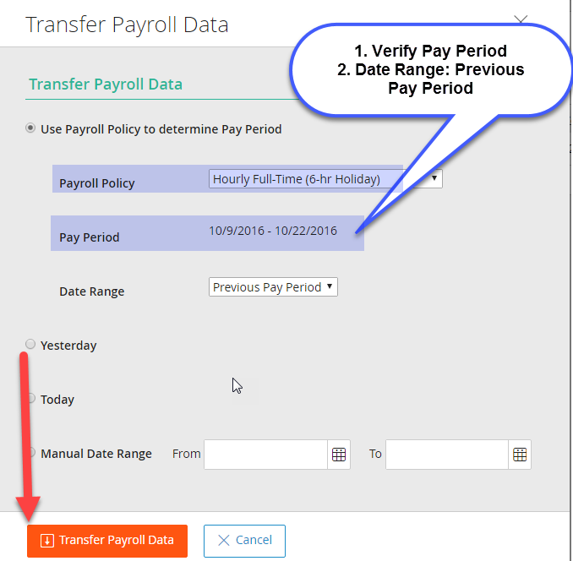
PAYROLL Do’s & DON’T’S

Slide 10
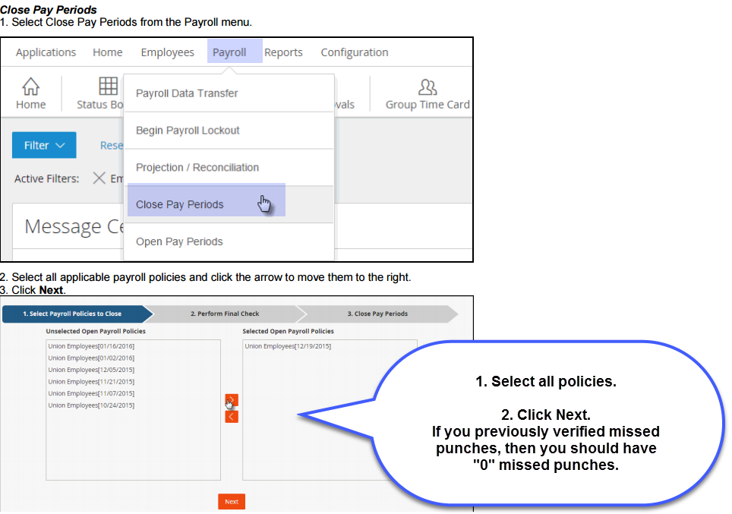
PAYROLL Do’s & DON’T’S
Once you are done with the data transfer, you can run reports such as Summary Payroll report, Web Pay Payroll Export and Summary of Pay Type Hours.

Slide 11
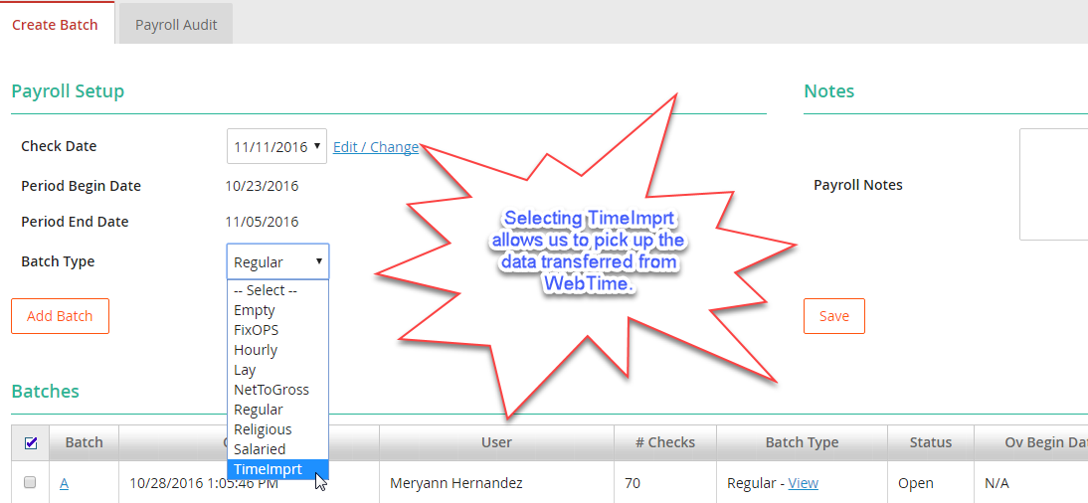
PAYROLL Do’s & DON’T’S
Almost there…..
Applications / Web Pay / Payroll/ Pay Entry/ Select Batch Type TimeImprt/Add Batch

Slide 12
PAYROLL Do’s & DON’T’S
Create New or Merge into Existing batch
Import WebTime file

Slide 13
PAYROLL Do’s & DON’T’S
QuickPay File is ready!
Make all necessary changes such as stipends, reimbursements, bonus, etc..
Click on batch totals
You can use the control screen to verify hours, see details of each line items and make changes!
The best tool to verify that all pay information is accurate prior to submitting payroll is the Preprocess Register.

Slide 14
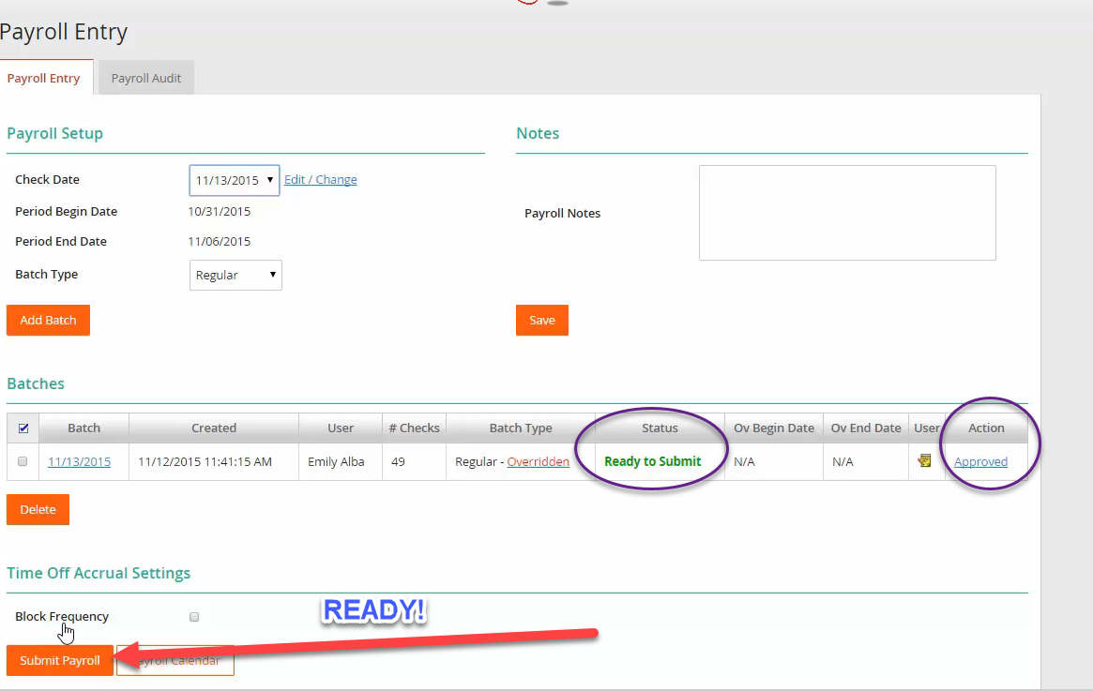
PAYROLL Do’s & DON’T’S
Once you have verified all information, you are ready to approve batch and submit payroll!

Slide 15
PAYROLL Do’s & DON’T’S
Once your payroll has been summited, please review your Payroll process reports. You may find them under Reports & Analytics/Payroll Process.

Slide 16
Paylocity updates
Year End Dashboard includes information and helpful tips on W-2s and 1095-C
Compare 2016 W-2 preview information with 2015
Select various employees: priest, part-time, yourself, full-time with all kinds of deductions
Are employees terminated before the conversion to Paylocity included in the preview?
Verify Company’s FEIN, Name, Address
Verify Employee’s SSN, Name, Address
Box 1: Gross wages minus deductions (403b, medical)
Box 12: 403b code E
Confirm that all voids & manual checks have been processed and the box 1 totals coincide with this.
Retirement Plan box checked: Employees eligible to contribute or are contributing to retirement plans (Employees/Employee info/Payroll Setup/Taxes)

Slide 17
Paylocity updates
Advantages:
Eliminate last minute payroll changes
Prevent errors from reaching employees
Reduce the need of reprints
Ensure accuracy prior to final production of forms

Slide 18
OTHER Paylocity updates
Mobile 2.0 – New update this November
Multi-Factor Authentication – Added security
Workflow Events – Company Admin and Supervisors can use the new message/memo feature to send messages to employees

Slide 19
OTHER Paylocity updates
Alert Alert! We have new Deduction codes:
R403B – 403B Roth
R4BNM – 403B Roth No Match
L403B – 403B Loan Repayment

Slide 20
Important Dates :
Nov 11 Payroll: Change Check date to Nov 10th. If not, employees will get paid on following business day (Monday, Nov 14th)
Nov 14: Corrections from 10/18-11/10
Dec 5: Corrections from 11/11 – 12/01
Dec 12: Corrections from 12/02 – 12/08
Dec 19: Corrections from 12/09-12/15
Dec 26: Corrections from 12/16 -12/22
Final 2016 W-2 Previews available Dec 26
Process last 2016 payroll by 4:00 pm, Dec 21 (Dec 23rd Payroll)
Submit 2016 adjustment payroll by 4:00 pm, Jan 5
RTC-6 4th QTR report will be available in Web Pay Jan 16
W-2s will be available in Web Pay Jan 21
W-2s, 1095Cs delivered by Jan 25

Slide 21
USE YOUR RESOURCES
Pastoral Center Support Team
Payroll Meryann Hernandez
Time and Attendance Jaime Tejeda
“Onboarding” new employees Janet Milian
ParishSoft – Jean-Paul Guis, Sindia Rosenay, Mary Otero
Paylocity -Training documents for Admins and Employees
(Web Pay / Home / Training Documents
Take OnDemand Courses
Help Text on every screen within Web Pay

Slide 22
USE YOUR RESOURCES
Contact Paylocity
Email: service@paylocity.com (include company ID on subject line)
Email: payrollsupport@paylocity.com (include company ID on subject line)
Phone: 1-888-873-8205
Pedro Mello-Diocese Coordinator: PMello@paylocity.com
Rob Salas –Client Services Manager Rsalas@paylocity.com
Felicia Ramirez –Client Services Team Lead Framirez@paylocity.com

Slide 23
Keys to success this year-end
Preview W-2s !!!!
Verify your Quarter End reports (RT-6s)
Make sure employees profiles are as accurate and as complete as possible
Share your suggestions/problems with us. We are all learning!!

Slide 24
Questions?

