Slide 1
LARGE EVENTS VS. SMALL EVENTS

Slide 2
EVENTS
Large and small events can be used for financial support, public awareness and to further the mission.

Slide 3
LARGE EVENTS

Slide 4
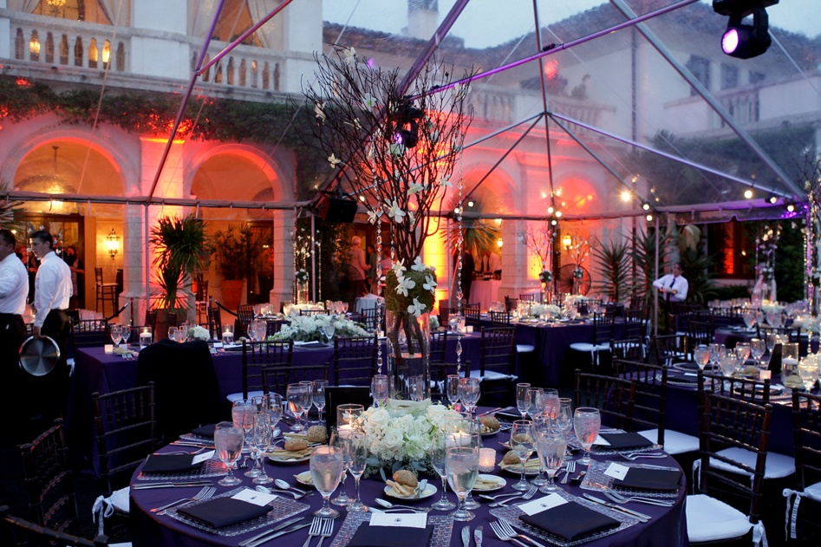
LARGE EVENTS
Raise Larger Amounts of $$$$$$$
Ties organizations to the philanthropic sector
Are ideal for acquiring & cultivating new prospects
Can retain or upgrade existing donors that can provide the organization with increased annual giving access to corporate partners
Can provide Public visibility for the sponsors - auctions

Slide 5
LARGE EVENTS
Provide roles and opportunities for volunteers
Marketing of your organization
Public relations – generate publicity in the media
Public awareness of the mission
Stewardship opportunity
more people (over 100)

Slide 6
SMALL EVENTS

Slide 7
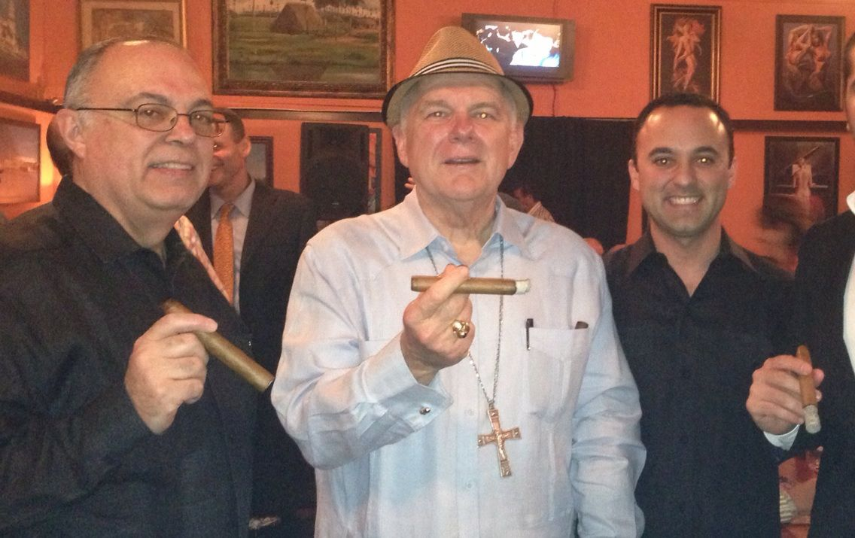
SMALL EVENTS
Raise small amounts of $
Tie the organization to the entire community
Have an attendance of Fewer numbers of people (more intimate)
Assist in building stronger relationships with current donors
Provide Public visibility for sponsors
Volunteer involvement
Stewardship opportunities

Slide 8
GOALS

Slide 9
GOALS FOR LARGE & SMALL EVENTS
COMMITTEE
What are your goals?
Your goals will determine the type of event
Your goal should help you tailor the event for the target market
Creativity and detail will be key

Slide 10
COMMITEES

Slide 11
ROLES AND NEEDS FOR COMMITTEE MEMBERS
CHAIR
Why are they important?
What can they do that you can’t?
What can they bring to the event?
What is their role?

Slide 12
ROLES AND NEEDS FOR COMMITTEE MEMBERS
What is the role of the committee?
What makes them so important?
Assist staff person
Assist with fundraising efforts

Slide 13
EXECUTION

Slide 14
SPONSORS, UNDERWRITING, AND TICKET SALES
Why do you need sponsors?
How do you identify sponsors?
How do you make an ask?
Why do you need underwriting?
List of underwriting opportunities

Slide 15
PRINT MATERIALS
Importance of design
Why should you print invitations?
How much should you spend on print materials?
E-vites
Who should you send invitations to?

Slide 16
RETURN ON INVESTMENT
3 to 1 formula
Budget template
Revenue
Response rate
Awareness
Stewardship

Slide 17
THANK YOU AND FOLLOW UP
Everyone likes to feel special
The seven “thank yous”
Tax deductible receipts
Data base

