Slide 1
Stewardship: The Mandate from Laudato Si’!
Presenters: Martha Velasquez and Grace Veloz

Slide 2
Session Overview
Provide a quick overview on the benefits of a spiritual stewardship program and the importance of a vibrant and inviting parish environment.
Review Pope Francis’s Encyclical tells us to “Till and keep.” We will provide the answer to cultivating and preserving our parishes not only as a renewal of our relationships with our parishioners but with the Lord.
Overall information on how to Increase offertory changing the fundraising strategy through Appeal campaigns, offertory envelopes and Online giving

Slide 3
The Mandate from Laudato Si’!
PRAISE BE TO YOU, O LORD!

Slide 4
WHAT DID POPE FRANCIS REALLY SAY????
Chapter Two, Pope Francis introduces “The Gospel of Creation,” in which he leads readers through the call to care for creation that extends as far back as the Book of Genesis, when humankind was called to “till and keep” the earth (67).
Genesis 2:15 “till and keep” which means going beyond cultivating to caring, overseeing, and preserving. The duty of the caretaker is not only for the land but for society and all its gifts.

Slide 5
WHAT DID THE POPE REALLY MEAN BY
‘TILL AND KEEP’?
Integral ecology “is not some narrow agenda for greening the Church or the world”. It is a vision of care and protection that embraces the human person and the human environment in all possible dimensions
“A great cultural, spiritual, and educational challenge stands before us, and it will demand that we set out on the long path of renewal.”
“Life gradually becomes a surrender to situations conditioned by Technology. Technology itself is viewed as the principle key to the meaning of existence.” Technology is not the faith or the solution. Only humans are concerned with the next life, or with the lives of future generations. Humans can construct, cultivate, interact with society and their community. Only through cultivation can you achieve consciousness and responsibility and through responsibility you attain generosity and sustainability.

Slide 6
HOW DO WE CULTIVATE AND PRESERVE OUR PARISHES
Make your Parishioners Stewards of the Church
Stewardship Formation
Catholics should learn not only more about stewardship and what it is, but also how to make better use of the gifts God has given them.
Inspire greater generosity and increase giving

Slide 7
WHAT IS STEWARDSHIP?

Slide 8
STEWARDSHIP
The word that describes our entire relationship with God. God loved and trusted us so much that he made us his stewards.
It is a way of life!
It is NOT a fundraising tool

Slide 9
Why is Stewardship Important to your parish?

Slide 10
Members recognized their gifts and are invited to use their gifts
Faith is nurtured and Parish Life flourishes
All who enter experience welcome and hospitality
Parishioners know and place in action their parish mission.
Liturgy inspires active participation and offers an experience of God
Shared leadership is practiced
There is a plan for a sustainable and responsible future
Vibrant Parish

Slide 11
HOW DO WE RENEW AND REVITALIZE OUR PARISHIONER’S RELATIONSHIP WITH THE CHURCH AND GOD?
We Rebuild!

Slide 12
THE REBUILDING PROCESS
Assess
Plan
Project
Participate

Slide 13
MAKE ASSESSMENTS
Has Mass attendance declined?
Do Parishioners feel Mass is “boring or bad? People will assume that God is boring and irrelevant to their life.
Is the Pastor accessible to all who need him?.
Do you have active Ministries?
Are you Providing a “Welcoming” environment?

Slide 14
REVITALIZE YOUR MUSIC MINISTRY
Music has the greatest potential to reach people
Make your Music Ministry, your Worship Ministry

Slide 15
PLAN
Establish or Invigorate your Parish Pastoral Council
Explore the pastoral reality
Generate a Parish Vision/Mission Statement
Reflect on it
Make pastoral recommendations
Institute or Fortify a Parish Financial Council
Establish guidelines and communication of parish financials
Annual Capital and Operating Budgets

Slide 16
PROJECT
Institute a Stewardship Council
Share the Parish Vision
Promotes, inform, and educate parishioners to become great stewards of the Catholic Church
Cultivates parishioners responsibly
Brings awareness to sharing all of God’s gifts lovingly

Slide 17
PARTICIPATE
Have People see other people participating through
a Parking Ministry, Welcome Ministry, and Prayer Groups
Welcoming Environment
Welcome table, registration, calling people with concerns, asking people to participate, calling back those who are interested in partaking and following up with those who have left.
Creating Community Time
Coffee and doughnuts after mass, spaghetti dinners , potlucks, etc
Have Parishioners take Action
Initiate ministerial activity by doing missionary work that takes place outside of the parish, including local and global outreach and service opportunities.

Slide 18
HOW TO ACHIEVE AN INCREASED OFFERTORY
WITHIN THE STEWARDSHIP PROGRAM

Slide 19
Stewardship creates the community environment and cultivates the durability ingredient for a sustainable Parish

Slide 20
WHAT ARE THE PRIORITIES OF INCREASED OFFERING FOR THE PARISH
Retaining and Increasing Donors
Increase Fundraising through Stewardship Appeal
Encouraging Fundraising efforts through online giving
Improving Technology
Increase Functions and Events.

Slide 21
HOW TO ACHIEVE AN INCREASE IN THE OFFERTORY WITHIN THE STEWARDSHIP PROGRAM:
Review Update and Analyze Parish Database
Market your Parish
Establish Online giving
Build and/or update online giving platform
Personalize correspondence and appeal to come from Pastor.
Thank and acknowledge Donors

Slide 22
REVIEW UPDATE AND ANALYZE PARISH DATABASE
Learn about your donors
Clean Parish Database
Establish a true number of families that you are ministering to divide Donors into 3 categories:
$2,000 +
$1 - $1,999
Non-givers

Slide 23
MARKET IN YOUR PARISH
Generate a Parish Brochure with parish information
Mass times, office hours, special events, ministries, worship and financials
Design and/or update your Parish Website
Create a Website with parish information, pictures of events and most important , online giving
Enter the world of Social Media
Fashion a Facebook page
Join Twitter and Instagram

Slide 24
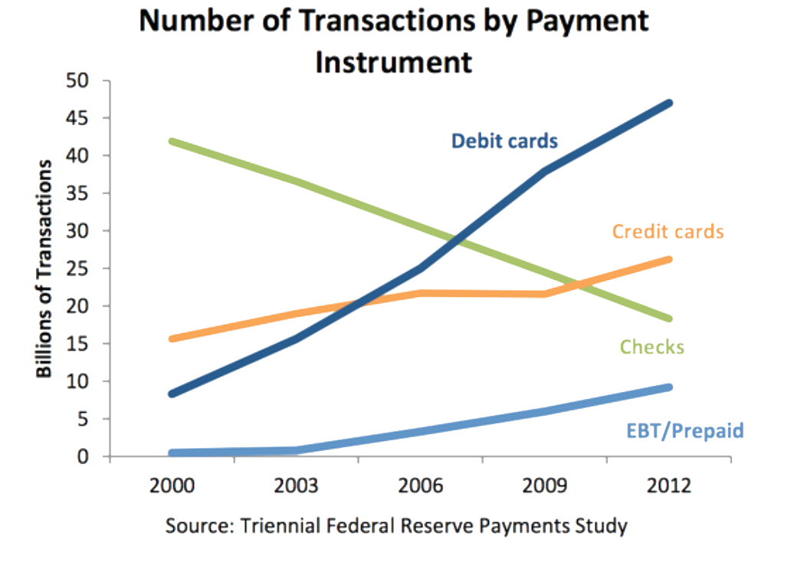

Slide 25
ESTABLISH AN ONLINE GIVING PROGRAM
Church Benefits
Contributors give up to 50% because they can plan
Donor Benefits
Donors feel online giving is mre efficient.
Donors take responsibility and witness a sense of Stewardship
Consistency allows Parish the ability to plan better
Church receives detailed reporting and “Thank You” letters are sent immediately
They have the choice of ACH or Credit Cards.
Donors can customized their method of giving
Donor can manage all their giving at once

Slide 26
PERSONALIZE APPEAL
Cultivate the Parishioner
Individual Correspondence
Personal appeal to come from Pastor
Need to ask at least 3 times in different ways

Slide 27
THANK AND ACKNOWLEDGE DONORS
Personal thank you letters from Pastor
Thank you cards from Council
Bulletin and Website Inserts acknowledging Commitment- no $ amount shown
Acknowledgement during mass
Appreciation events depending on category of donation
Thank in person at the event
NEED TO THANK 7 TIMES- giving is proportionate to the appreciation
The more you thank, the more they give.

Slide 28
Q & A
If you would like additional information beyond this session, please contact Martha Velasquez or Grace Veloz at mvelasquez@theadom.org or gveloz@theadom.org.

