Slide 1
Whatdd’ya Say?
Telephone business etiquette

Slide 2
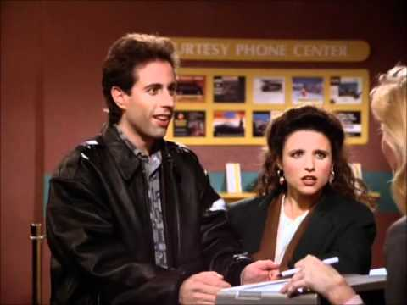
Business Telephone Etiquette Tips
When we talk by the phone we are also representing the organization we work for.
General rules that apply when we answer the phone follow:

Slide 3
When the phone rings
Do not permit the phone to ring more than three times.
If your coworker is busy on another call, and you can assist, pick up the phone for him
If your line rings and you are busy on the phone with a caller, ask politely a coworker to pick up the call for you.
Do not answer the phone if you are eating or chewing gum.

Slide 4
Answering the Call…
Speak clearly and smile as you answer the phone
Identify yourself.
Ask if you can be of any assistance.
Address the caller properly by Mr./Mrs.
Use good morning/good afternoon.
Ask politely for the person’s contact information.
Listen carefully to what the person is telling you.
Picture paints 1000 words.
Use normal tone
If you have direction from your supervisor to ask the purpose of the phone call please do so politely and respectfully. (One might ask “May I ask the purpose of the phone call?”

Slide 5
As you speak…
Always use a pleasant and friendly tone.
Never interrupt the person while he/she is talking to you.
Never engage in an argument with a caller.
Do not handle an unhappy caller’s phone call on speaker.
Never put anyone on speaker without their permission or without telling them who else is listening.
Do not use slang or jargons ex. Yeah, instead of yes.

Slide 6
Can I put you on a brief hold?
If you are going to place a caller on hold, ask for permission first.
Ask the magic phrase: “Is it ok with you if I put you on a brief hold?
If the caller is fine with it, thank him/her.
Some people are not particularly fond of being put on hold.
Don’t leave the person on hold for too long.
It is better to return a call than to keep someone on hold for more than 5 seconds.
If necessary for longer hold continue to update the caller.

Slide 7
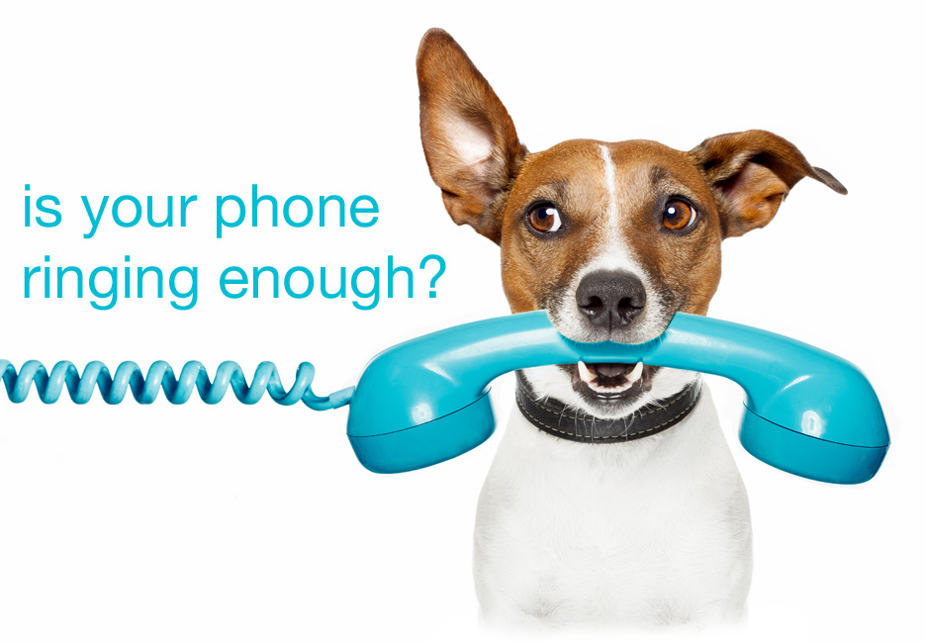
If you promise to call back…do so!
Do not forget to return the call as you promised.
Callers are trusting you to return their call and help them through.
Do not give the impression that you are rushed. It is better to return the call when you can.
Photo courtesy tEkk3.com

Slide 8
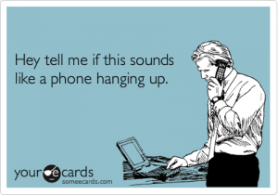
Sealing the deal…the hang up!
Thank the caller for his patience and for taking the time to call your organization.
Provide a telephone to call back in case of further questions.
Always get the best number and time to have a call returned to the caller.
When hanging up the phone, make sure the caller or person called hangs up first.
Always hang up the phone gently and in a cordial manner.

Slide 9
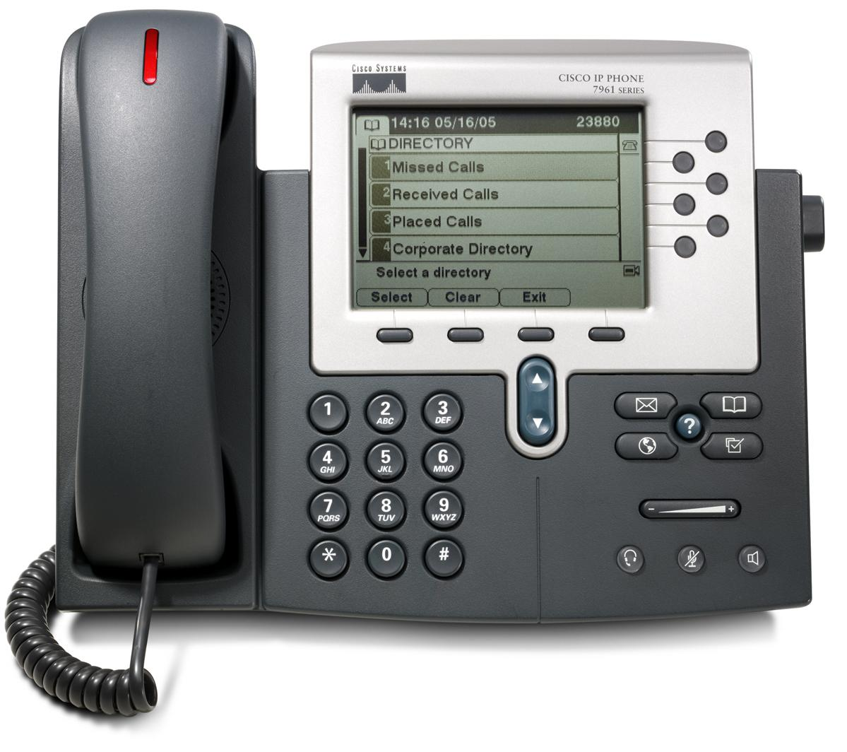
When the call regards a serious matter
Do not leave a message or voice mail with details on a sensitive matter. Instead, ask the person to call you back and let them know you need to discuss “important/sensitive information”.

Slide 10
In general
Do not call anyone before 8:00 a.m. or after 9:00 p.m., unless you have the caller’s permission to do so.
Return calls promptly that have been left on voice mail.
Handle several callers simultaneously with ease and grace.
Do not make it a habit of receiving personal calls at work.
When leaving a voicemail be concise, clear and repeat your phone number twice.
When on vacation or away from your office for a day your voicemail message should state that you are not reachable and provide other contact information for the caller.

Slide 11
How to transfer a call
Ask the person, “may I put you on a brief hold?”
Call the person you are going to transfer to letting him/her know about the call.
Let the caller know you will be transferring him/her to the right person and give the extension number in case the caller gets disconnected.
If the right person is not available for the transferred call, ask the caller if he/she wants to go into voicemail. If not, ask them to call later and repeat the phone extension or number.

Slide 12
How to place an outgoing call
When your phone call is answered say “Good morning or good afternoon”
Identify yourself and who you represent
Ask to speak to the person you are calling
If asked the purpose of the call, give a brief answer such as: “Father would like to schedule a meeting”, “I’m returning the call to Father Smith”, or “it’s a personal issue”.
Be polite and courteous.
If it is necessary to leave a message, repeat your name and phone number two times.
Thank the person for their help.
Say good bye!

Slide 13
Whatdd’ya Say?
E-mail business etiquette

Slide 14
Setting the Tone
E-mail correspondence must be considered as a “live” conversation.
What’s missing in e-mails are facial and body language signals.
Tone and intent of the message can be misunderstood in e-mails more easily than in person.
To manage the tone of any e-mail
Never write or respond to an e-mail when you are angry or upset… “step away from the computer”
Always re-read your e-mail before hitting the send button.
Be very careful to whom you CC: and forward your e-mails.
Only include pertinent information when sending a business e-mail; do not include personal information.
Never make a comment or a statement that is unkind, unprofessional or un-pastoral in any e-mail communication.
NEVER WRITE AN E-MAIL WITH CAPS.
When unable to receive e-mails due to vacation schedules or days out of the office leave an “out of office” e-mail message which should include the dates you are away and a contact information to assist the sender in your absence.

Slide 15
Bonus points…
Remember to return e-mails ASAP
E-mails live forever in cyberspace…the delete button means nothing.
God gave us spell-check…please use it!!
Just because you send an e-mail does not mean communication has been made or concluded…Follow up until the two-way stream of communication is complete.

Slide 16
THANK YOU

Slide 17
Sources
http://customerservicemanager.com/20-business-telephone-etiquette-tips.htm
http://voices.yahoo.com/20-telephone-etiquette-tips-businesses-332085.html
http://www.buzzle.com/articles/telephone-etiquette-tips.html

