Slide 1

Building the Kingdom
Building and Property Office
Introduction to Project Management Fundamentals
Presenter:
David O. Prada AIA, LEED AP
Senior Director, Building
and Property Office

Slide 2

Building the Kingdom
Building and Property Office
Mission Statement:
To Support the Archdiocese of Miami in Proclaiming the Good News of Christ through the work that we do related to its Buildings and Properties. We are charged with being faithful stewards of Archdiocesan assets, and with providing professional guidance and assistance to Church entities in the planning and overseeing of maintenance and construction projects.
When planning a project for your parish refer to the detailed ADOM Building and Property Office Project Procedures Outline (refer to handout)

Slide 3
Building the Kingdom
Building and Property Office
Workshop Goals:
Gain a Better Understanding of:
  Basic Project Management Fundamentals
  What is SCOPE CREEP?
  What is a Total Development Budget?
  What is the CRITICAL PATH?
  Different Project Delivery Methods
  Archdiocese of Miami Project Procedures (different project types)
  ADOM (Re) Roofing Project Requirements
  ADOM Insurance Claim Project Procedures
  ADOM Project Closeout Requirements
  Hurricane Preparedness
  Additional Resources the ADOM can provide to you.

Slide 4
Building the Kingdom
Building and Property Office

Slide 5



Building the Kingdom
Building and Property Office
PROJECT FUNDAMENTALS
EVERY PROJECT AND CONTRACT MUST DEFINE 3 ELEMENTS TO BE EFFECTIVE (AND LEGAL):
  Scope (what is included/excluded in the project?)
  Budget (what is the cost of the project?)
  Schedule/Time (how long will project take?)

Slide 6

Building the Kingdom
Building and Property Office
PROJECT FUNDAMENTALS
$$ SCOPE OF WORK $$
  Clearly define the project needs and objectives.
  Prepare a detailed program of the spaces needed in the project so that an accurate budget and schedule can be prepared.
  Is anything excluded? Furniture, Finishes, Equipment?
  A properly prepared SOW will eliminate or minimize SCOPE CREEP….

Slide 7
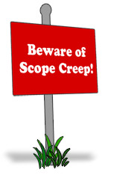
Building the Kingdom
Building and Property Office
WHAT IS SCOPE CREEP????
Scope creep refers to uncontrolled changes or continuous growth in a project scope. This phenomenon can occur when the scope of a project is not properly defined, documented, or controlled and results in a delayed schedule and project budget overruns
Typically it results from the project team drifting away from its original purpose and scope into unplanned additions. As the scope of a project grows, more tasks must be completed within the budget and schedule originally designed for a smaller set of tasks. If budget, resources, and schedule are increased along with the scope, the change is usually considered an acceptable addition to the project, and the term “scope creep” is not used.
  Scope creep can be a result of:
    poor change control
    lack of proper initial identification of what is required to bring about the project objectives.
    weak project manager.
    poor communication between project team members.

Slide 8

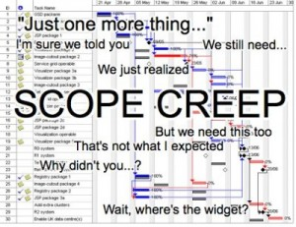
Building the Kingdom
Building and Property Office

Slide 9
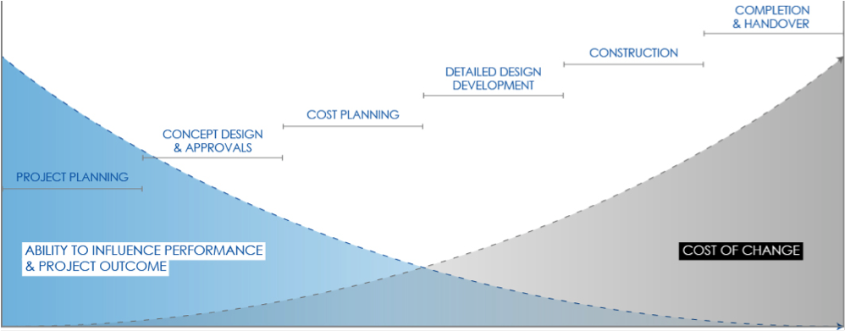
Building the Kingdom
Building and Property Office

Slide 10
Building the Kingdom
Building and Property Office
PROJECT FUNDAMENTALS
$$ BUDGET $$
  “BUDGET” = TOTAL DEVELOPMENT BUDGET
  Total Development Budget is the total of
  Project Soft Costs + Project Hard Costs
  3. Is anything excluded? Furniture, Finishes, Equipment?

Slide 11
Building the Kingdom
Building and Property Office
Soft Costs Include:
  Architect and Engineering Fees
  Project Manager Fees
  Geotechnical Test
  Surveys
  Permit Fees/Impact Fees
  Water and Sewer Fees
  Legal Fees
Hard Costs Include:
  Temporary Trailers
  Construction/Bricks and Mortar
  Furniture, Fixture, Equipment
  Finishes and Decoration
  Audio and Visual Systems
  IT and Computer Systems
  Contractor Fees

Slide 12

Building the Kingdom
Building and Property Office
PROJECT FUNDAMENTALS
$$ SCHEDULE $$
  IN A PROJECT TIME IS MONEY. Any delay in finishing will result in additional SOFT and HARD costs…
  The project schedule must be understood as a series of tasks arranged in a CRITICAL PATH.

Slide 13
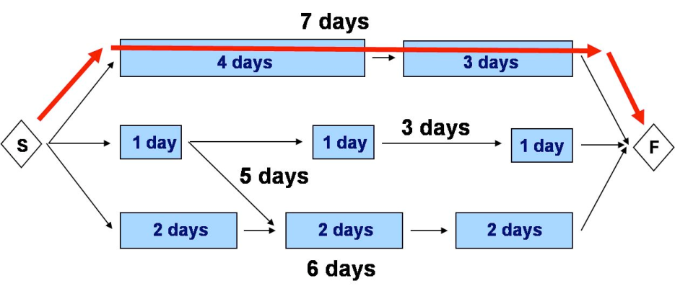
Building the Kingdom
Building and Property Office
THE CRITICAL PATH SCHEDULE
The Project Critical Path the following:
  A list of all activities required to complete the project,
  The time (duration) that each activity will take to completion,
  The dependencies between the activities and,
  Logical end points such as milestones or deliverable items.
  A project schedule may include many simultaneous tasks, but only those in the sequence required to finish the project on time are included in the CRITICAL PATH.

Slide 14
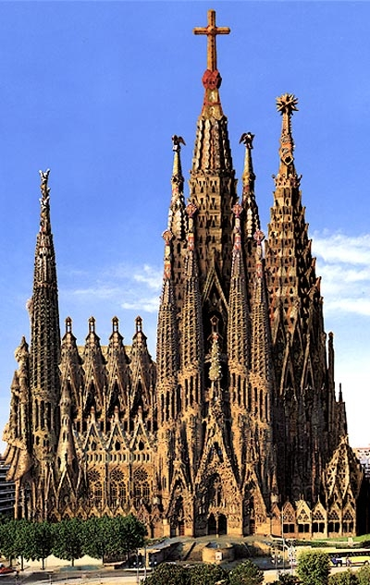
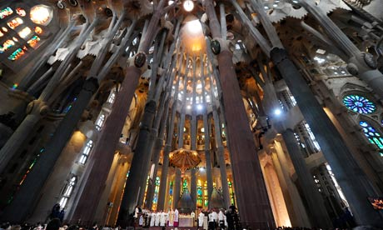
Building the Kingdom
Building and Property Office
PROJECT FUNDAMENTALS
Once the Scope, Budget, and Schedule are Defined a decision is made regarding how the project will be ‘DELIVERED’. The available choices include:
  Traditional Design-Bid-Build
  Design-Build
  Construction Management

Slide 15
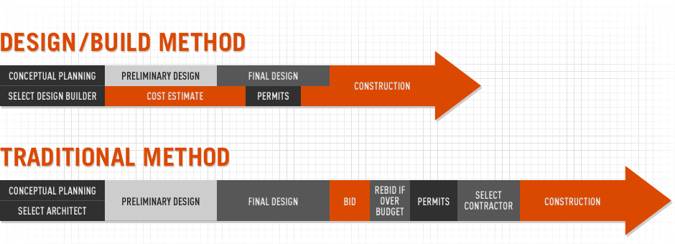
Building the Kingdom
Building and Property Office

Slide 16
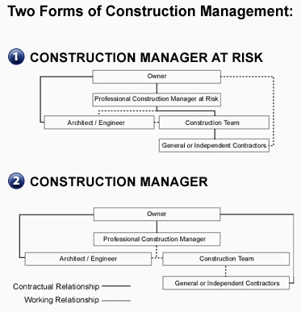
Building the Kingdom
Building and Property Office

Slide 17
Building the Kingdom
Building and Property Office
ARCHDIOCESE OF MIAMI PROJECT PROCEDURES
EMERGENCY PROJECTS
SMALL CONSTRUCTION PROJECTS (UNDER $25,000)
MINOR Capital Construction Projects (minor renovations, remodeling, maintenance, and roofing $25,000 or more)
MAJOR Capital Construction Projects (new buildings, major remodeling and expansions)
Miscellaneous Project types (40 year recertifications, building demolition, violations, Carnival Agreements)

Slide 18

Building the Kingdom
Building and Property Office
Emergency Projects (Fires, Floods, Broken Waterlines)
First: ACT to Address the emergency locally:
  Stay Calm, Stay Safe!
  Call 911 if emergency is life threatening and warranted (fire, injury, etc…)
  Turn off water valves, use extinguishers only if safe to do so.
Second: Call GB Hotline @ 877-376-2561 (client 060001)
  (THIS # SHOULD BE READILY AVAILABLE AND PROGRAMMED
  IN YOUR CELL PHONES)
Third: Call David Prada (305-951-4058 cell)

Slide 19
Building the Kingdom
Building and Property Office
Small Projects (Under $25,000)
Call Building and Property Office for assistance and guidance.
Parish must define (Building and Property Office can help):
  Scope (what is included in the project? Are permits needed?)
  Budget (what is estimated total value of the project-hard/soft cost)
  Time (how long will project take?)
Parish obtains Bids/Prices/Insurance Documents from 3 Qualified Vendors and prepares ADOM Contract.
  * BEFORE soliciting 3 bids/prices you must provide the vendors the following in order to confirm they can meet ADOM requirements:
  ADOM Standard Construction Contract (even if Pro-Bono)
  ADOM Insurance Requirements (even if Pro-Bono)
Submit all documentation to Building and Property Office for review. All contracts, permits, and forms that need “OWNER SIGNATURE” are submitted to the Building and Property Office for verification and signature by Archbishop Wenski as Owner.

Slide 20
Building the Kingdom
Building and Property Office
Minor Capital Projects (additions, renovations, remodeling, maintenance, and roofing $25,000 or more)
Call Building and Property Office for assistance and guidance.
Pastor requests Project Approval from Archbishop for project concept and finances (copy to Chancellor for Administration), including confirmation that the Parish Finance Council has approved the project.
Archbishop’s written approval is sent to pastor
Building Property Office assists Parish during design and construction process:
  Preparing complete Scope, Budget, and Schedule
  Selecting and Hiring Architect and Contractor
  Preparing Contracts (ADOM or Other)
  Ensure all Vendors meet ADOM Insurance Requirements.
  Assist with project management services (in house or outsourced).
  Assist parish to manage Budget and Schedule
  Obtaining permits and navigating gov’t agencies.
  Interface with Archdiocesan attorney as needed.
Submit all documentation to Building and Property Office for review. All contracts, permits, and forms that need “OWNER SIGNATURE” are submitted to the Building and Property Office for verification and signature by Archbishop Wenski as Owner.

Slide 21
Building the Kingdom
Building and Property Office
Major Capital Projects (additions, renovations, remodeling, maintenance, and roofing $25,000 or more)
Call Building and Property Office for assistance and guidance.
Pastor requests Project Approval from Archbishop for project concept and finances (copy to Chancellor for Administration), including confirmation that the Parish Finance Council has approved the project.
Archbishop’s written approval is sent to pastor.
Review Concept and preliminary drawings with ADOM Project Review Committee.
Building Property Office assists Parish during design and construction process:
  Preparing complete Scope, Budget, and Schedule
  Selecting and Hiring Architect and Contractor
  Preparing Contracts (ADOM or Other)
  Ensure all Vendors meet ADOM Insurance Requirements.
  Assist with Project Management Services (out sourced)
  Assist parish to manage Budget and Schedule
  (including direct purchase tax savings)
  Obtaining permits and navigating gov’t agencies.
  Interface with Archdiocesan attorney as needed.
Submit all documentation to Building and Property Office for review. All contracts, permits, and forms that need “OWNER SIGNATURE” are submitted to the Building and Property Office for verification and signature by Archbishop Wenski as Owner.

Slide 22
Building the Kingdom
Building and Property Office
Miscellaneous Projects:
Call Building and Property Office for assistance and guidance.
40 Year Re-Certifications
  Notice is sent to Parish from Building and Property Office
  Parish IMMEDIATELY hires AE team to prepare and submit report (time sensitive and fines may be incurred).
  Parish funds and makes any required corrections.
Notice of Violations
  Notice is sent to Parish from Building and Property Office
  Parish notifies Building and Property Office of plan to resolve violation or request assistance from Building and Property Office .
Carnival Agreements
  Submit the following to Janet Rancano in Building and Property Office
  Carnival Agreement (current version- rev 8-8-2012)
  Certificate of Liability
  Permits

Slide 23
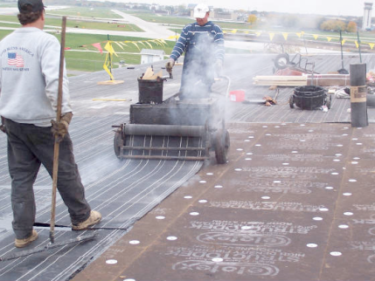
Building the Kingdom
Building and Property Office
ARCHDIOCESE OF MIAMI
(RE) ROOFING REQUIREMENTS
  Maintain your roofs and follow recommendations provided in your parishes annual Roof Management Report.
  Required to maintain existing roof warranties
  Call the ADOM Building and Property Office Prior to installing a new roof or performing roof repairs as required to meet minimum installation and warranty requirements for
      Flat Roofs
      Tile Roof
      Shingle R
      Metal Roof
  ADOM team will assist in bidding, construction inspections, and closeout.

Slide 24

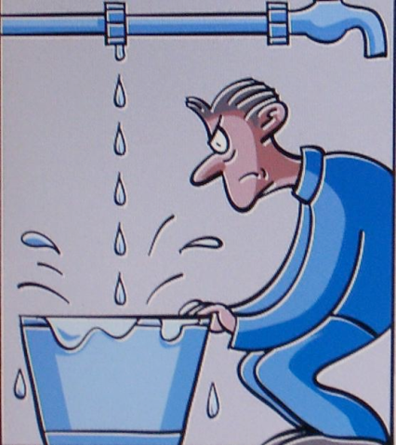
Building the Kingdom
Building and Property Office
INSURANCE CLAIM PROJECT PROCEDURES
Claim is called in and GB makes contact within 24 hours
GB provides estimate is to ADOM within 3 days +/-
ADOM Project Manager to schedule a meeting at site with 3 contractors
and provides GB scope without pricing
Estimates/bids are due to ADOM within 3-5 business days
  Required documents
    Scope
    Budget
    Schedule
    Insurance
ADOM awards contract within 48 hours based on approved budget
ADOM Project Manager advises GB of final contract amount
GB issues check to and mailed to ADOM (closes claim)
  CLOSEOUT PROCESS PRIOR TO ISSUING CHECKS
    ADOM PM site visit to verify the work is complete
    Contractor submits invoices and Project Closeout
    Checklist Completed.
ADOM issues check to contractor
Parish issues deductible to contract

Slide 25
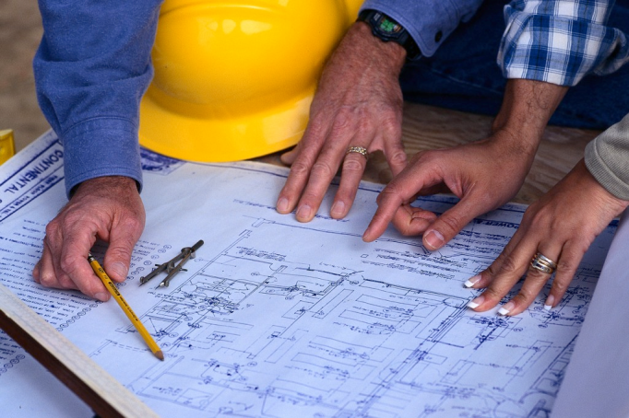
Building the Kingdom
Building and Property Office
PROJECT CLOSEOUT REQUIREMENTS
WHEN A PROOJECT IS “FINISHED” AND THE CONTRACTOR WANTS TO BE PAID, NO FINAL PAYMENT/RELEASE OF RETAINAGE SHALL BE ISSUED UNTIL A REPRESENTATIVE FROM THE BUILDING AND PROPERTY OFFICE HAS VERIFIED THAT THE WORK HAS BEEN SATISFACTORILY COMPLETED AND THE CLOSEOUT CHECKLIST SUCCESSFULLY COMPLETED
Closeout Check List Required Prior to Final Payment/Release of Retainage:
□AE/Owner Confirmation that Punchlist has been satisfactorily completed.
□Final Release of Liens (all trades)
□ Warranty Letter from Contractor and all Trades (per contract)
□ Contractor’s Final Payment Affidavit (notarized)
□ Evidence of permits and subpermits closed
□ Contractor verified As-Builts of completed work in PDF format and electronic on CD.
□ Project O+M Manuals from each Sub Contractor
□ CD with all the above in electronic format

Slide 26
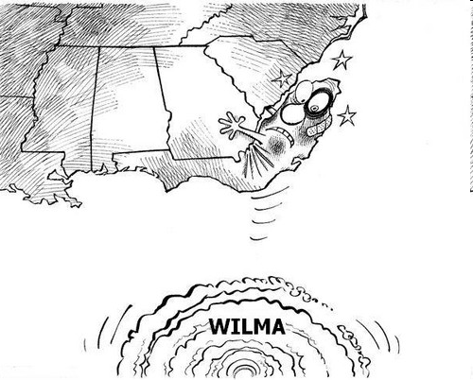
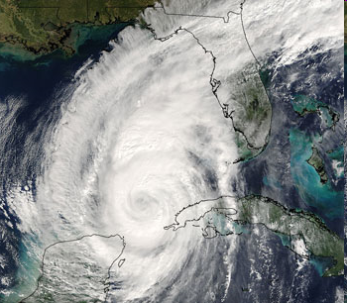
Building the Kingdom
Building and Property Office
HURRICANE PREPARATIONS
BE PREPARED

Slide 27
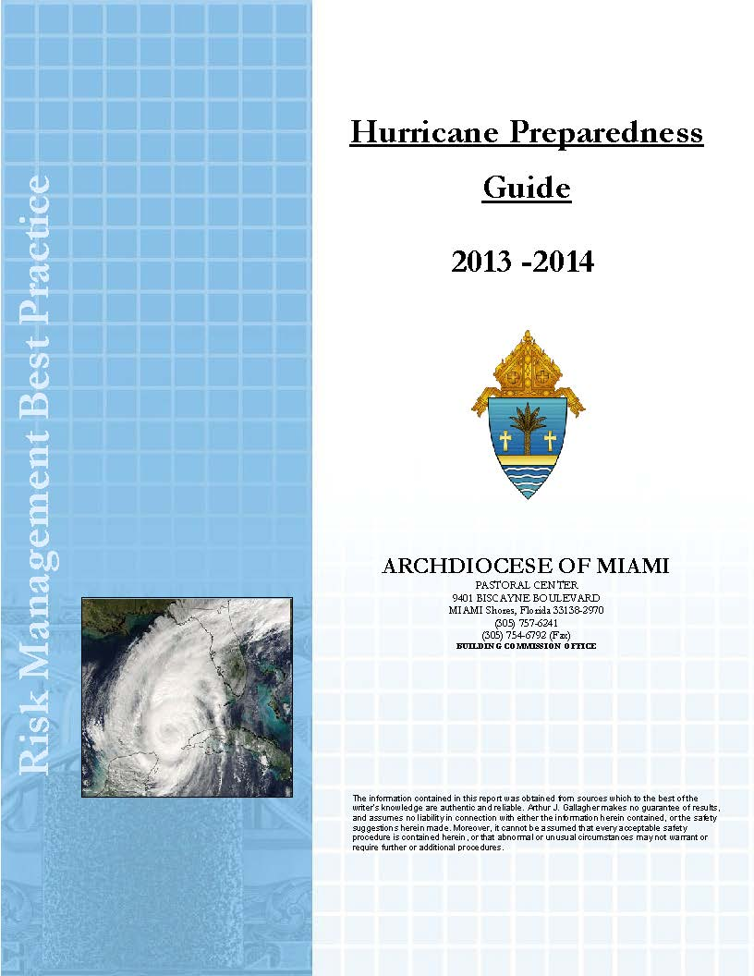
Building the Kingdom
Building and Property Office
Official Information and ADOM Policies
Communication Plan
What to do Before/After the Storm
Hurricane Supply List
How do Hurricane Insurance Deductibles Work?
Storing and Protecting Records
Lists and Forms
ADOM First Responder Services

Slide 28
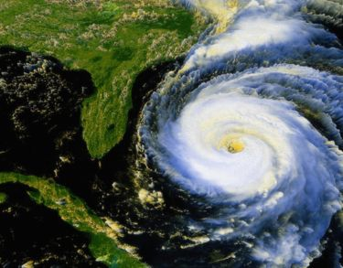
Building the Kingdom
Building and Property Office
Before the storm:
  Stay Calm and don’t panic!
  Be Prepared: Read the 2013-2014 ADOM Hurricane Preparedness Guide and prepare your parish’s hurricane preparation plan.
    www.theadom.info in the Building and Property/Facilities Management folder
  Always maintain shutters and emergency accessories clean and operational (oil permanent shutters), test generators, and batteries.
  Trim trees and clean clogged gutters.
  Implement Hurricane plan and Protect Parish Property (install shutters, protect electronics, etc…).
After the storm:
  Stay Calm and Stay Safe!
  Follow the directions provided in the
  2013-2014 ADOM Hurricane Preparedness Guide

Slide 29

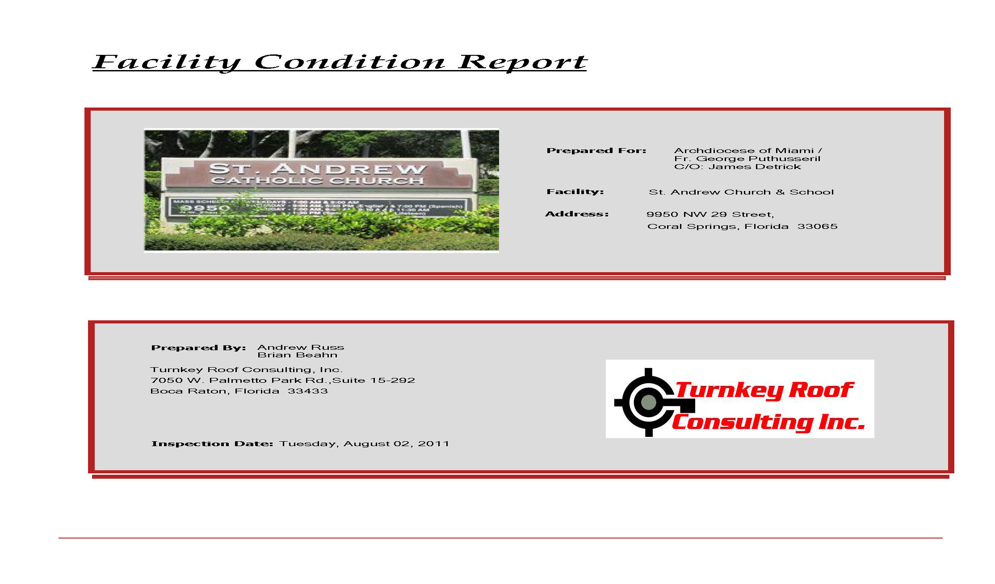
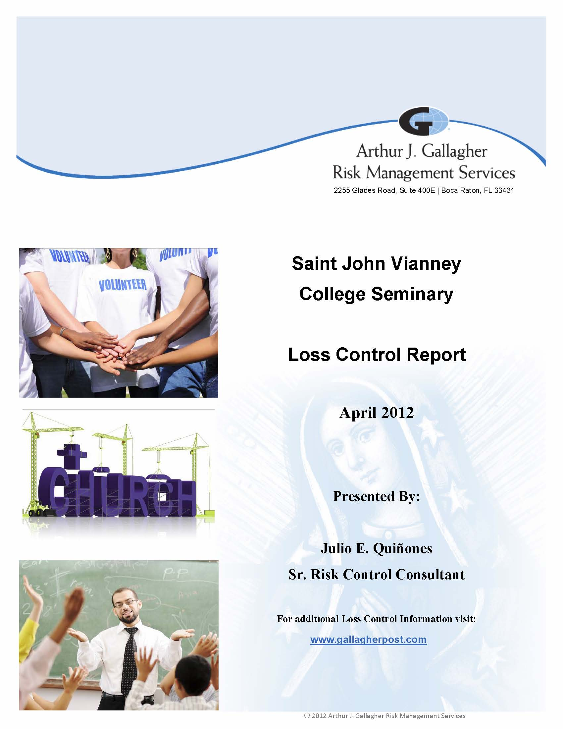
Building the Kingdom
Building and Property Office
USE the Tools the ADOM Provides to help you….
Safety Notices Roof evaluations Loss Control report
Risk Mitigation
When in doubt call the Building and Property Office 305.762.1032

Slide 30
Building the Kingdom
Building and Property Office
Introduction to Project Management Fundamentals
QUESTIONS???

