Slide 1
Logos
403b Employee withholding and employer match set up

Slide 2
Things we will go over…
Set amount should be a percentage
You must individually calculate the employer contribution. 50% of the first 6% contributed by the employee – NEVER more than 3%
Setting up your vendor
Creating the employee deduction
Creating the employer match

Slide 3
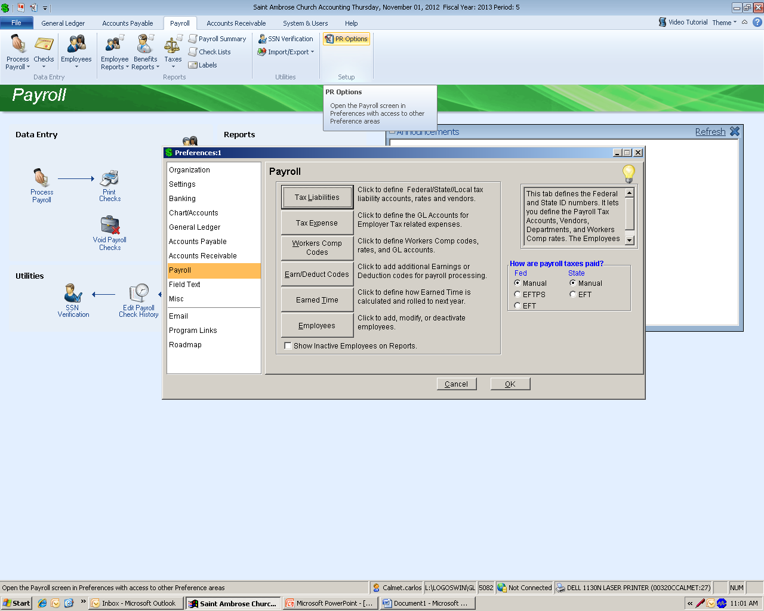
Setting up the vendor (1 of 3)
In the Payroll module, click payroll options, then select “Earn/Deduct Codes”

Slide 4
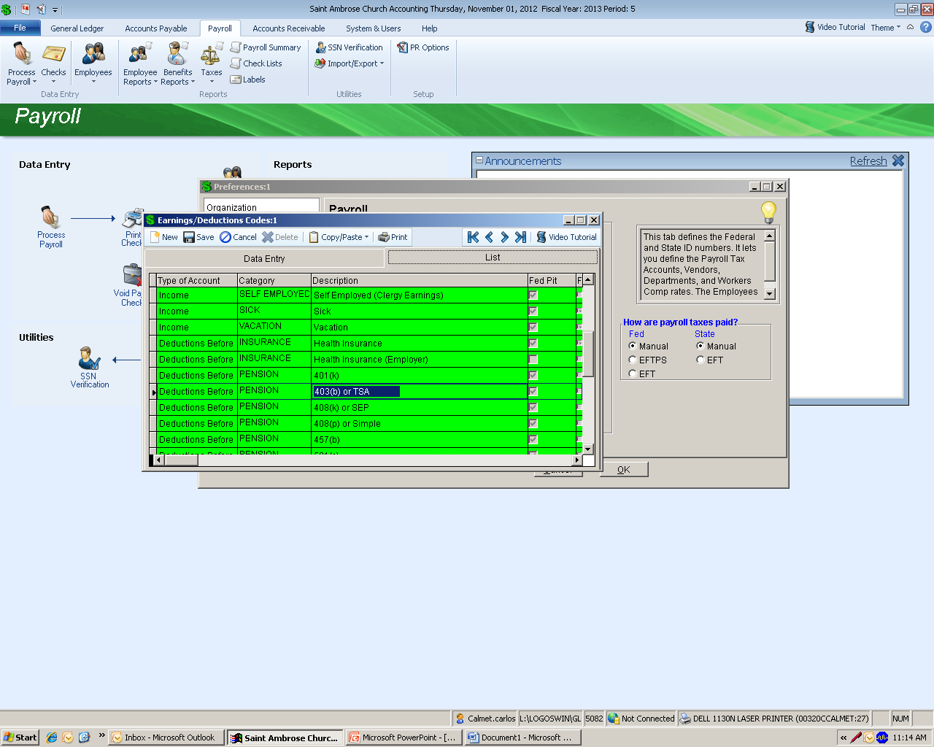
Setting up the vendor (2 of 3)
Click on the “List” tab, scroll down to find 403(b) or TSA, and double click.

Slide 5
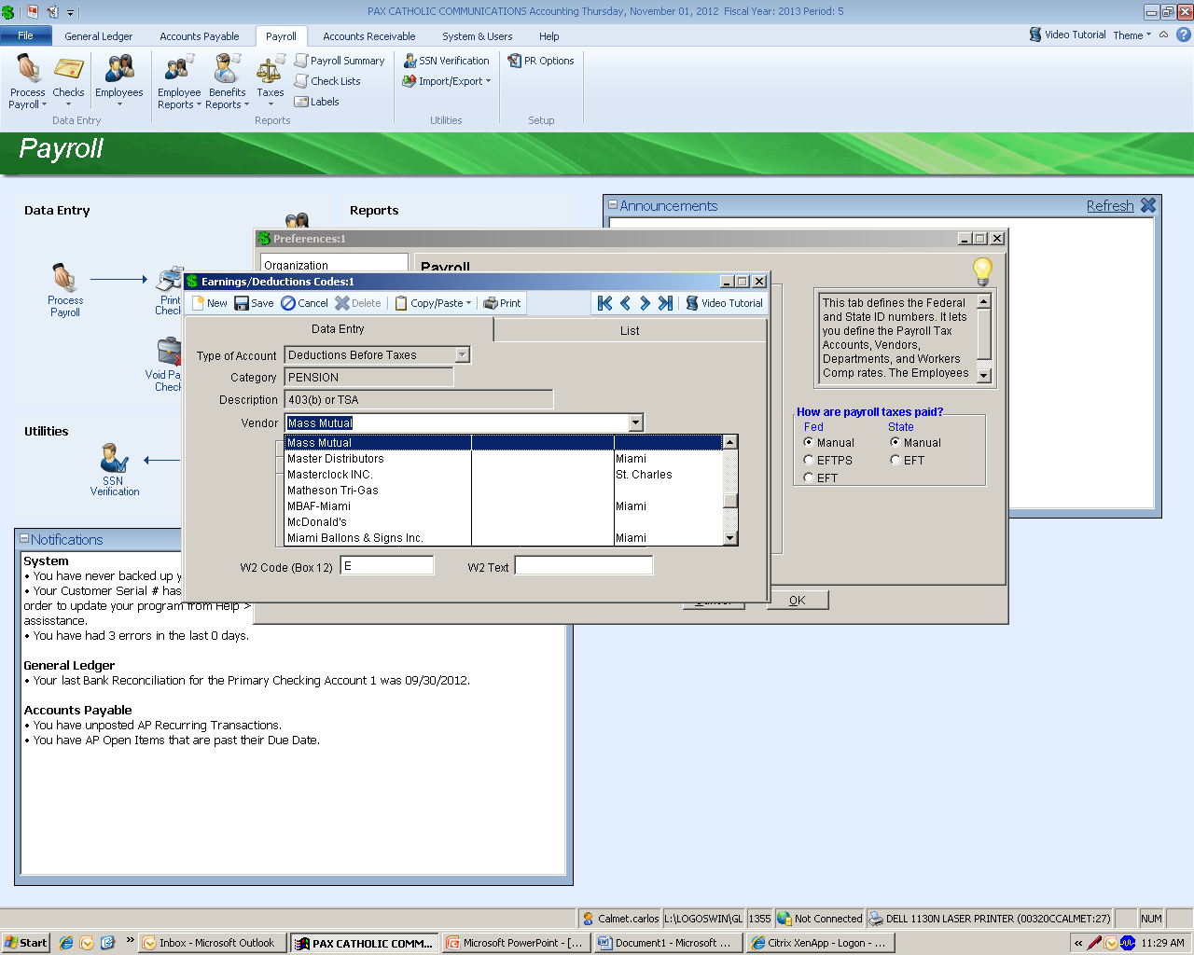
Setting up the vendor (3 of 3)
Finally, simply select your vendor, and click save.

Slide 6
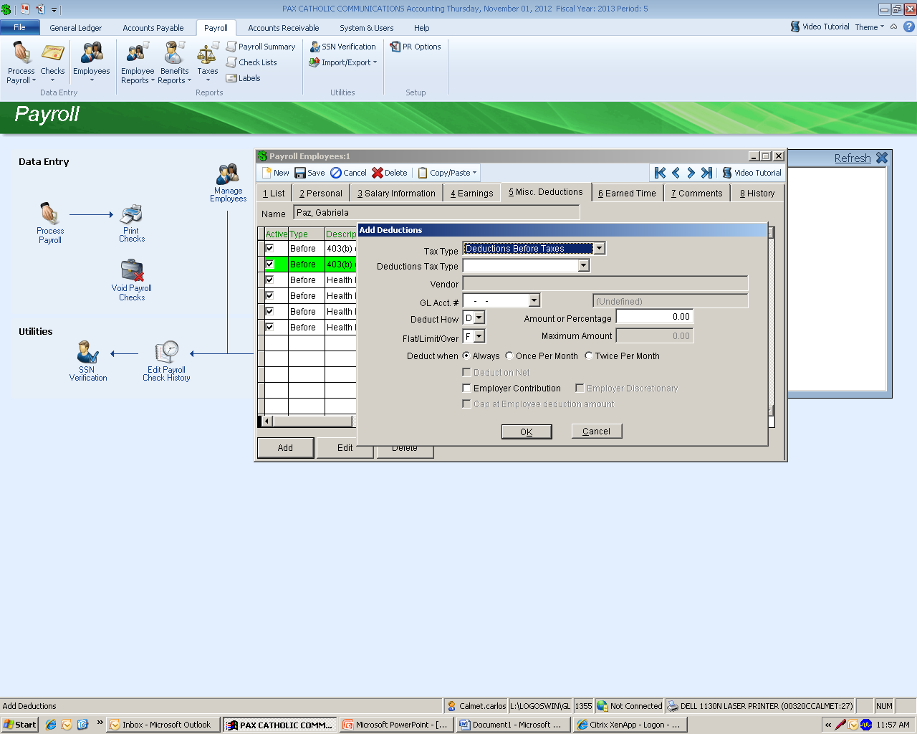
Creating the employee deduction (1 of 3)
Payroll module: click on “Manage Employees”, select your employee, click on tab 5 (Misc. Deductions) now you are ready to “Add” your deduction.

Slide 7
Creating the employee deduction (2 of 3)
Filling out the information:
Tax Type: Deduction Before Taxes
Deductions Tax Type: 403(b) or TSA
Vendor: Mass Mutual (In this case)
GL Acct # :2108-0000-000 (Voluntary PR Deduction)
Deduct How: “P” (Percentage)
Amount or %: Employee’s %
Flat/Limit/Over: “L” (Limit)
Maximum Amount: This amount changes each year please check with United capital b-4 the first payroll of the year.
2013 - $17,500 for employees under 50
- $5,500 additional catch up for employees over 50
- $3,000 additional for employees employed more than 15 years
Deduct when: Always

Slide 8
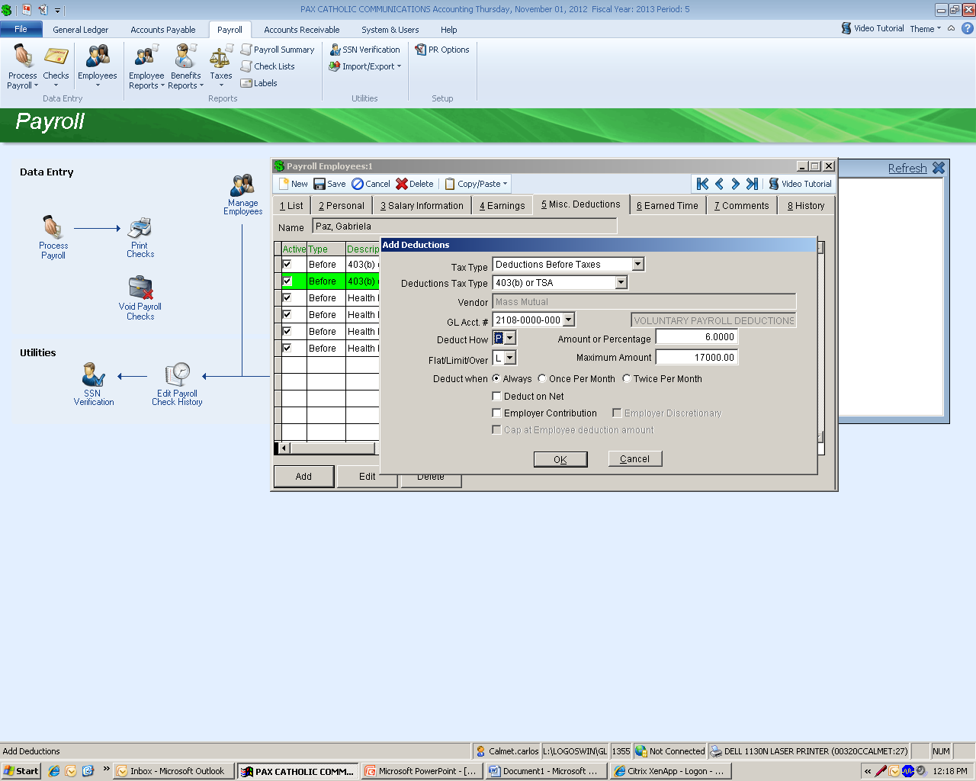
Creating the employee deduction (3 of 3)
Click ok! ☺

Slide 9
Creating the employer match (1 of 2)
Follow the same exact steps as the employee set up.
This time select the expense acct. 5154-0000-100
Select “the employer’s match” -50% of the first 6% contributed by the employee – NEVER more than 3%
Make sure to select Employer Contribution & Cap at Employee deduction amount.
Click ok! ☺

Slide 10
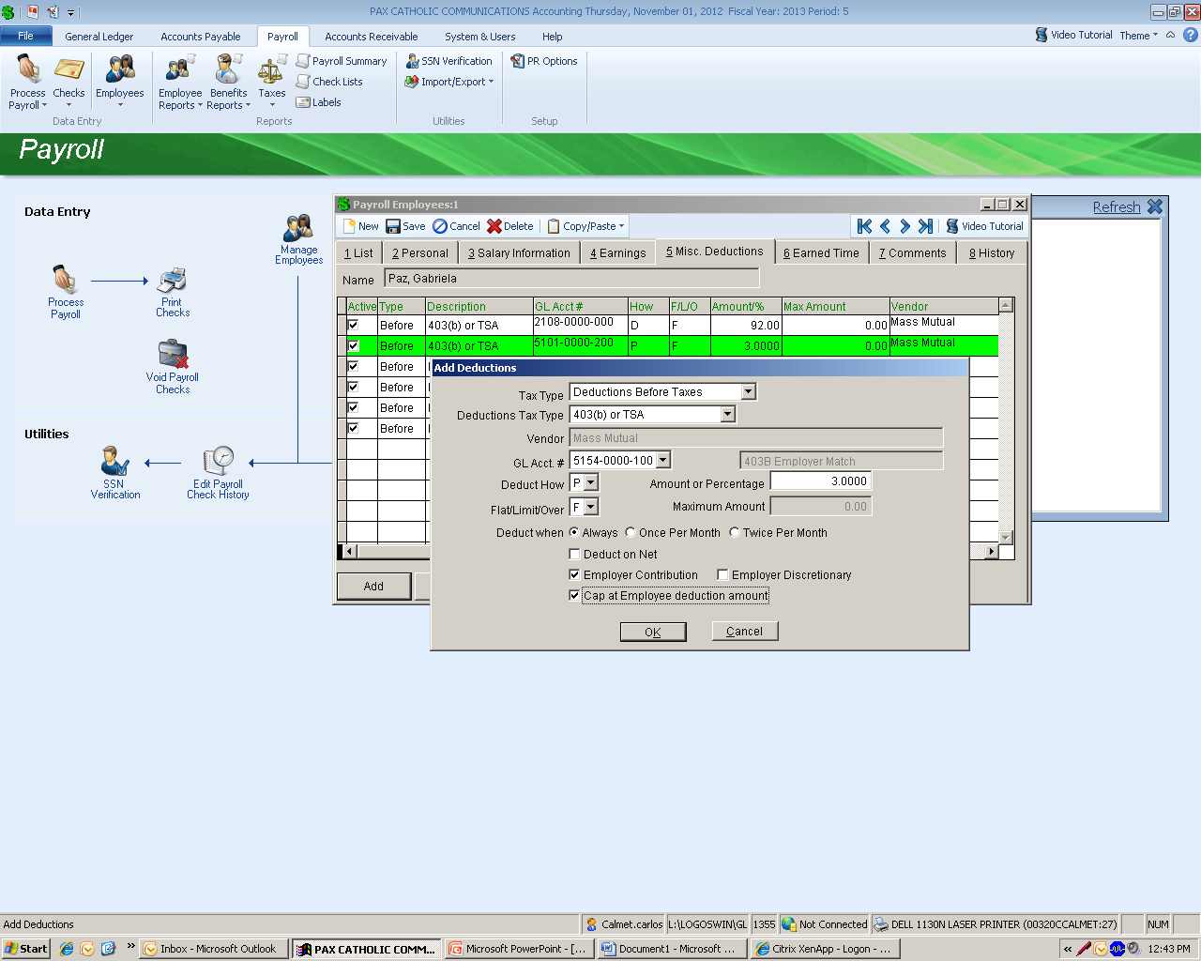
Creating the employer match (2 of 2)
Once you click ok, you will see your employer portion highlighted in green, finally, click save.

Slide 11
Contact information
Carlos Calmet
ccalmet@theadom.org
Jean Paul Guis
jguis@theadom.org
United Capital
carolina.uribe@unitedcp.com
Benefits Office – Pat Corredor
403b@adomhealthplan.org

